Slide 1

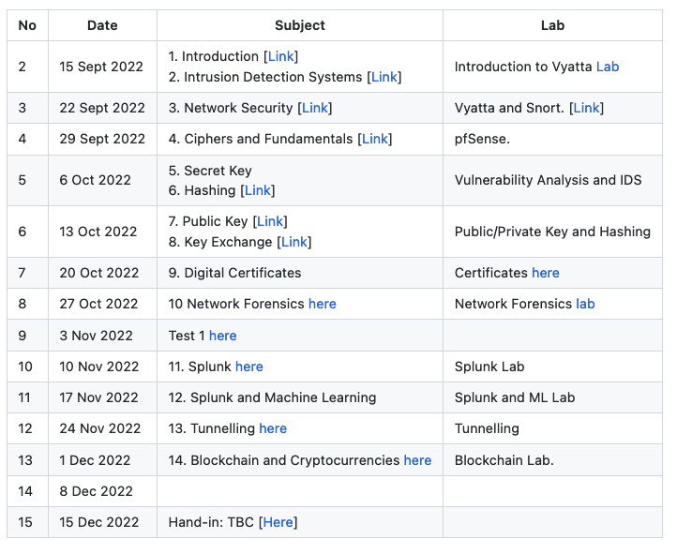


Defence Systems, Policies and Risks
“From bits to information”

Slide 2
Defence Systems, Policies and Risks
“From bits to information”

Slide 3
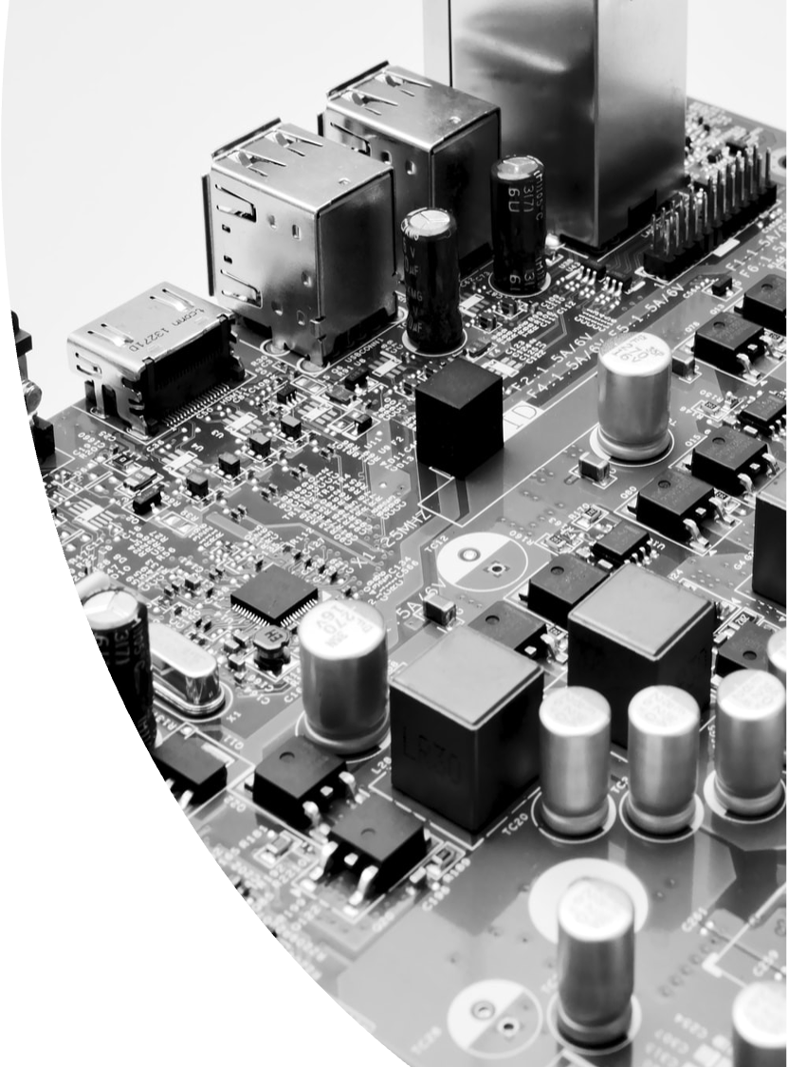
Outline
Data, Information, Knowledge and Wisdom.
Information Security and Forensic Computing.
Impact and Harm.
Risks, Costs and Benefits.
Kill Chain Models.
Defence Mechanisms.
Defence-in-Depth.

Slide 4
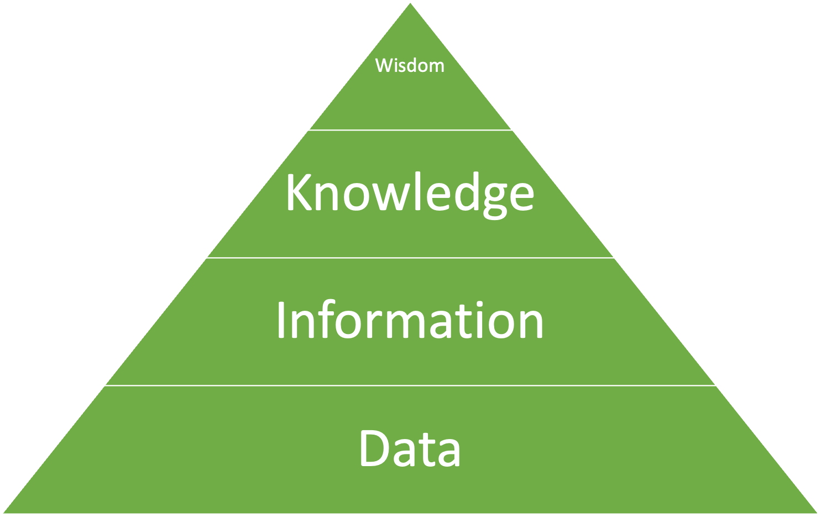
Data to Wisdom

Slide 5
Security, Incident Response and Forensic Computing
“From bits to information”

Slide 6
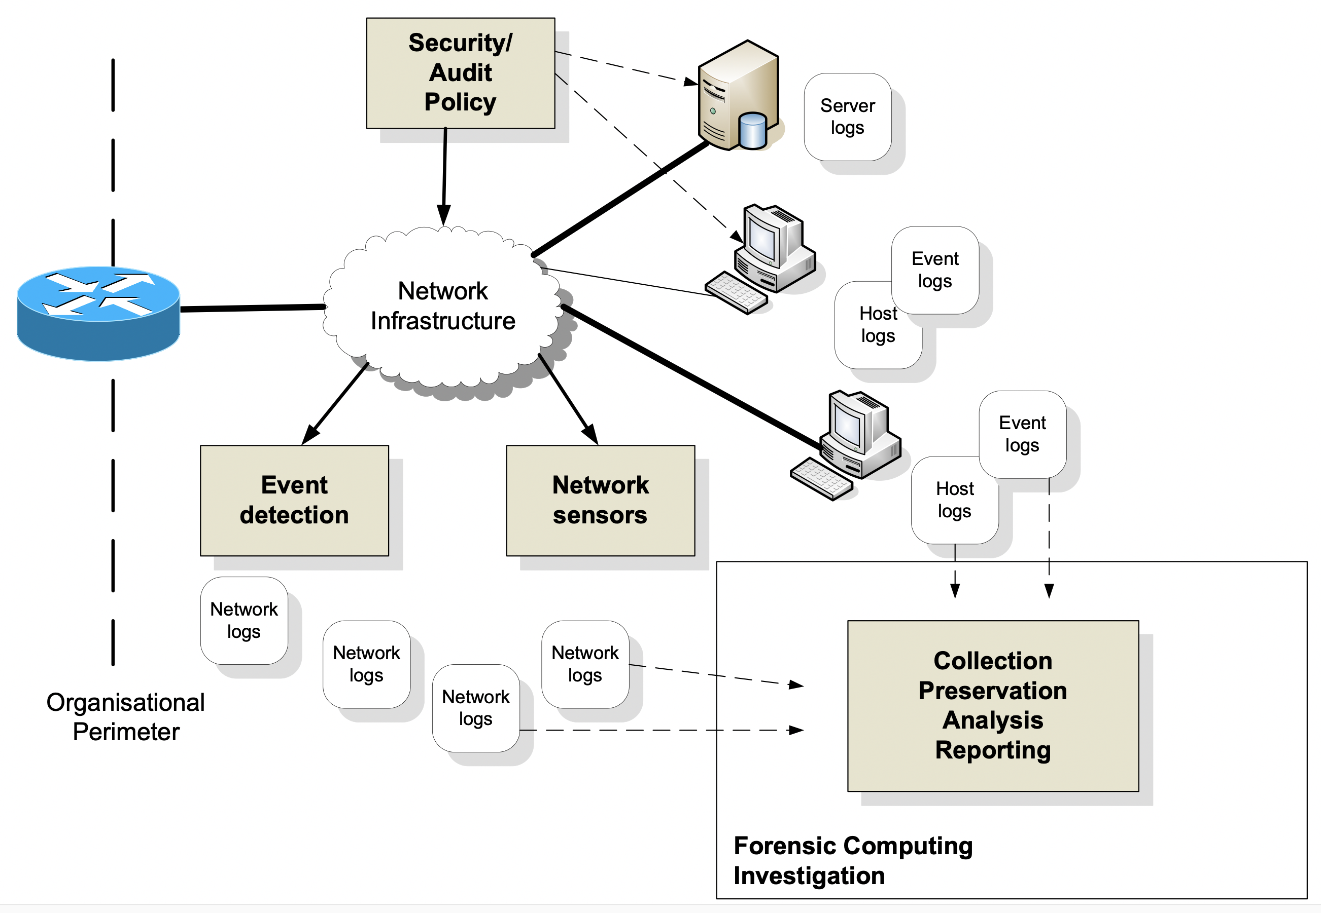
Information Security

Slide 7
Investigation
Investigating an intrusion on a system (incident response). This might lead to a criminal prosecution, but most of the time the intrusion is investigated in order to be able to detect it in the future, and to thwart the activities at an early stage.
Investigation of a criminal activity (forensic computing). This might lead to a criminal prosecution, or to thwart the activities in the future.
Investigation of a breach of security policy. This might lead to a disciplinary procedure within an organisation.

Slide 8
Due Care and Due Diligence
With due care, the organisation must make sure that it has taken the correct steps in the creation and implementation of its security policy and in its risk analysis.
Then due diligence relates to the actual operation and maintenance of its security system, especially around vulnerability testing. Thus a company might take due care in analysing and designing their security policy, but not take due diligence in actually proving that it works. It can work the other way, in that a policy might be implemented with due diligence, but the originally creation of the policy has not been properly analysed/designed. It is thus important, in terms of any future liability, that security systems are designed, analysed, implemented and maintained with both due care and due diligence.

Slide 9
Impact and Harm
“From bits to information”

Slide 10
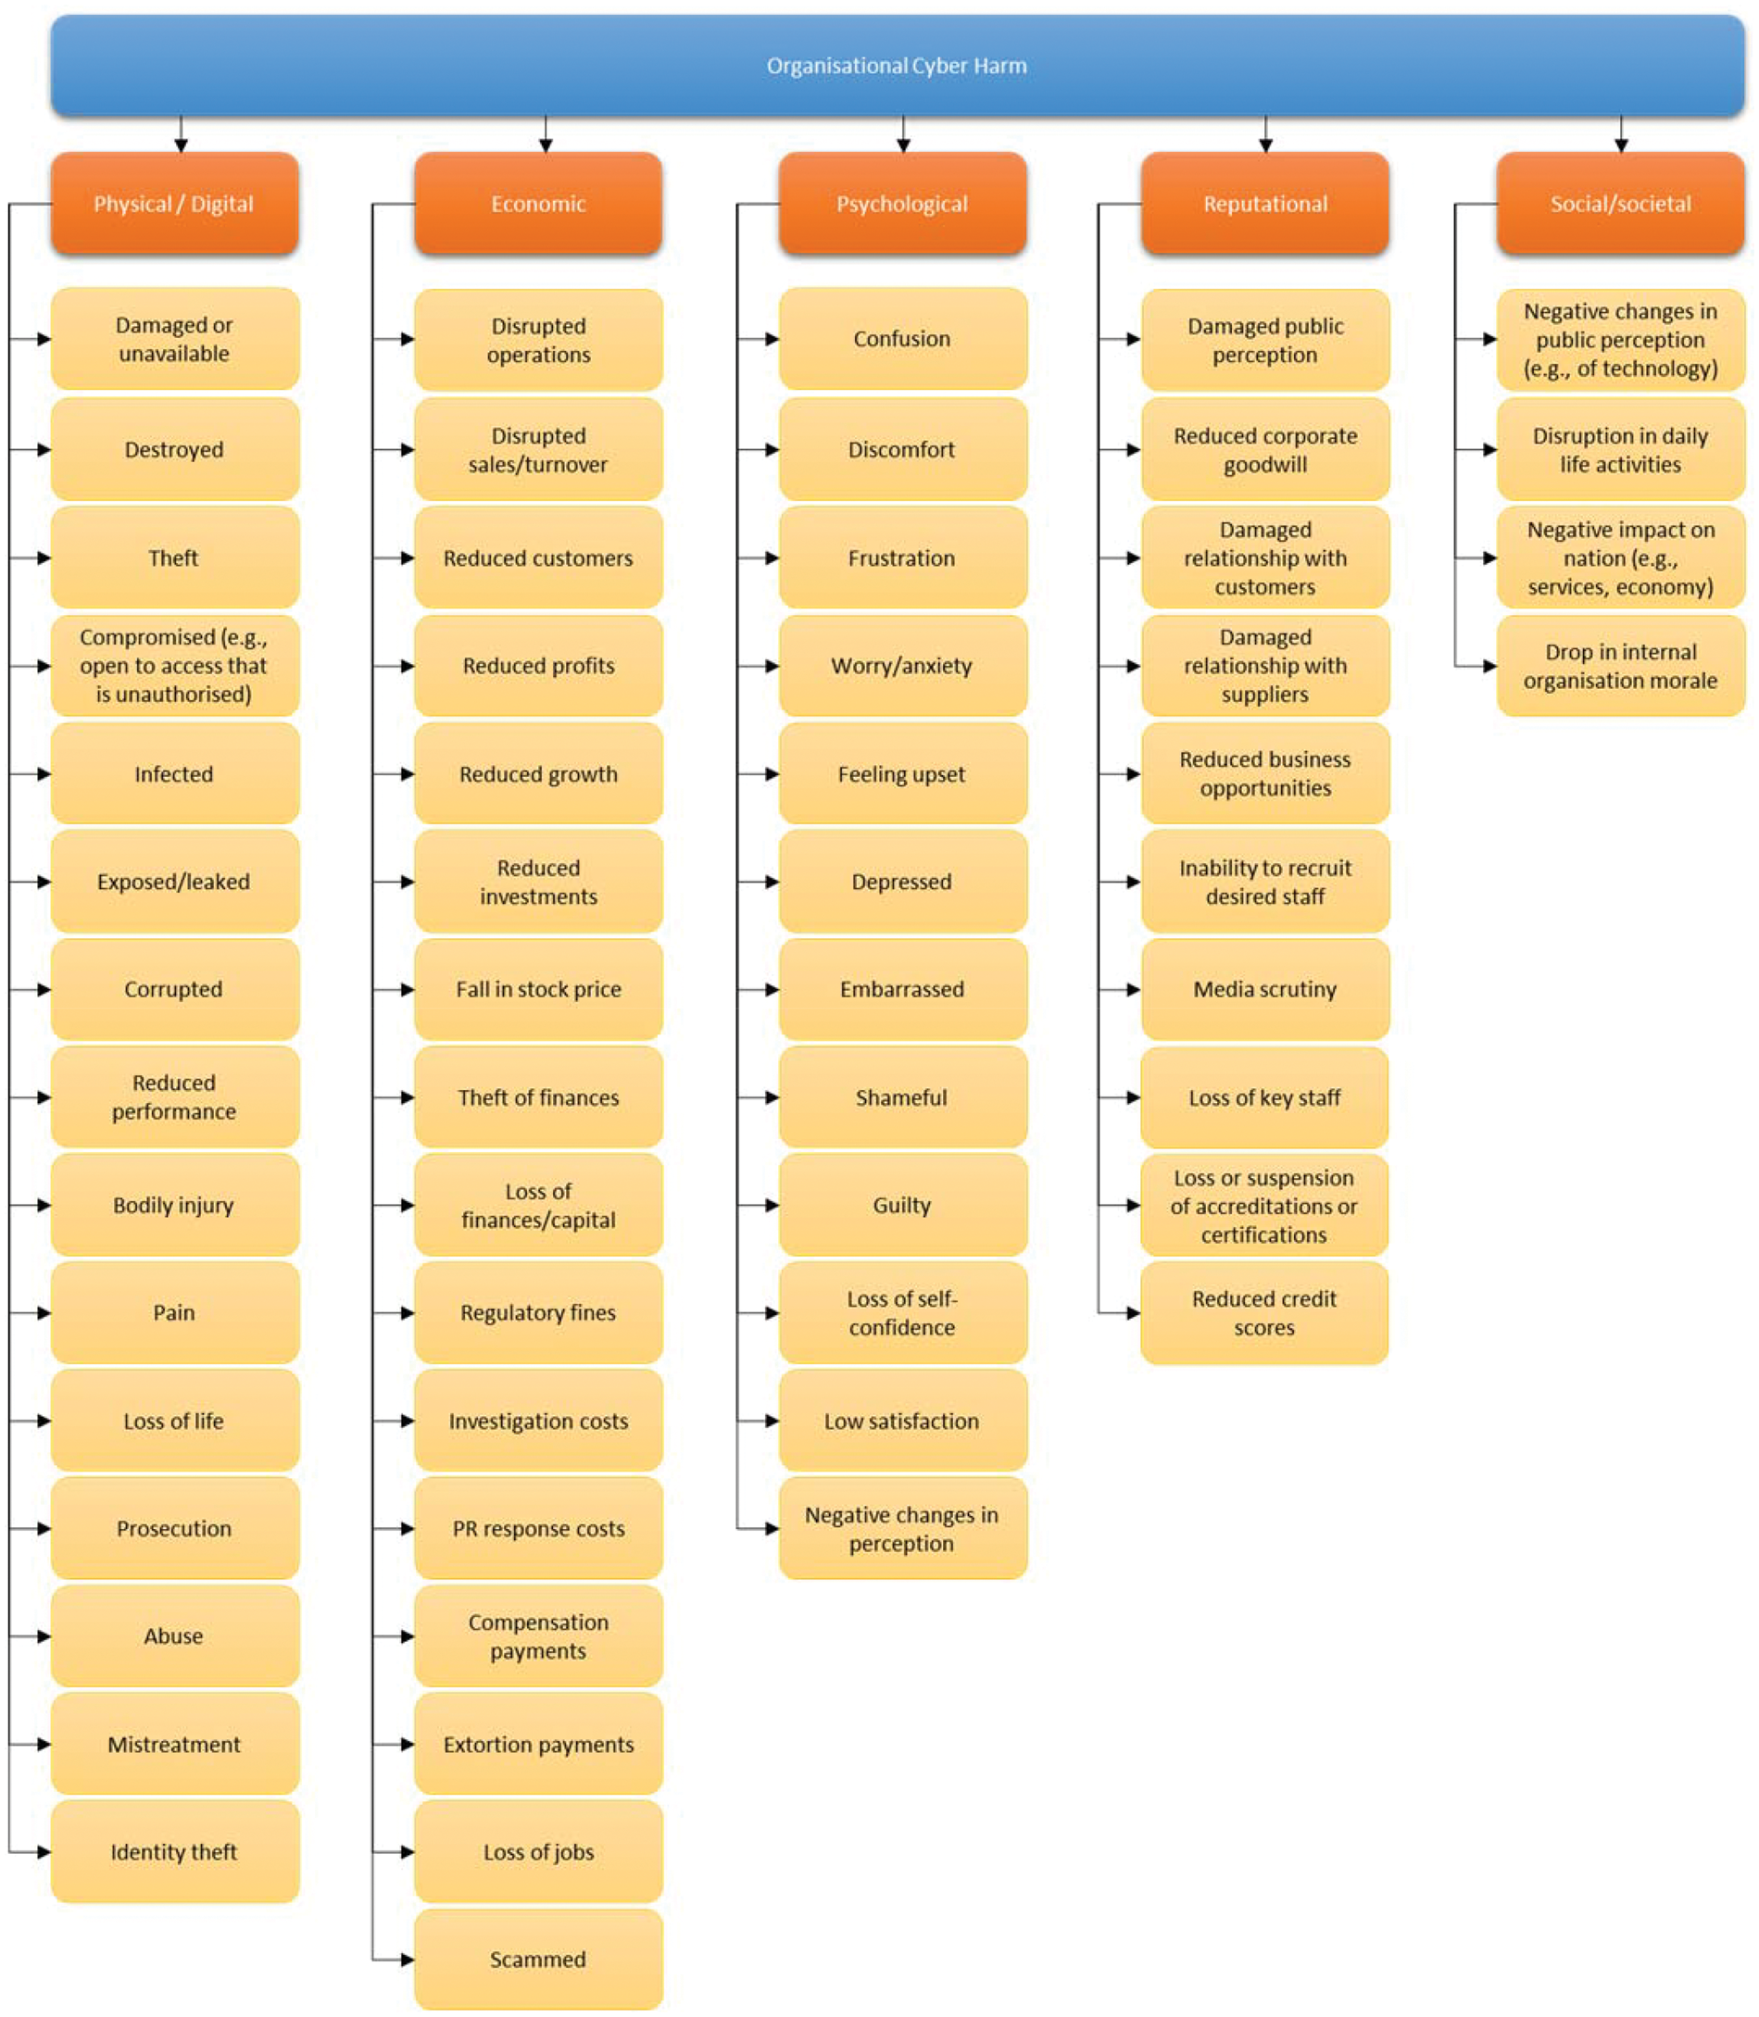
Impact and Harm
Physical or Digital harm.
Economic harm.
Psychological harm.
Reputational harm.
Social and Societal harm.

Slide 11
Risks, Costs and Benefits
“From bits to information”

Slide 12
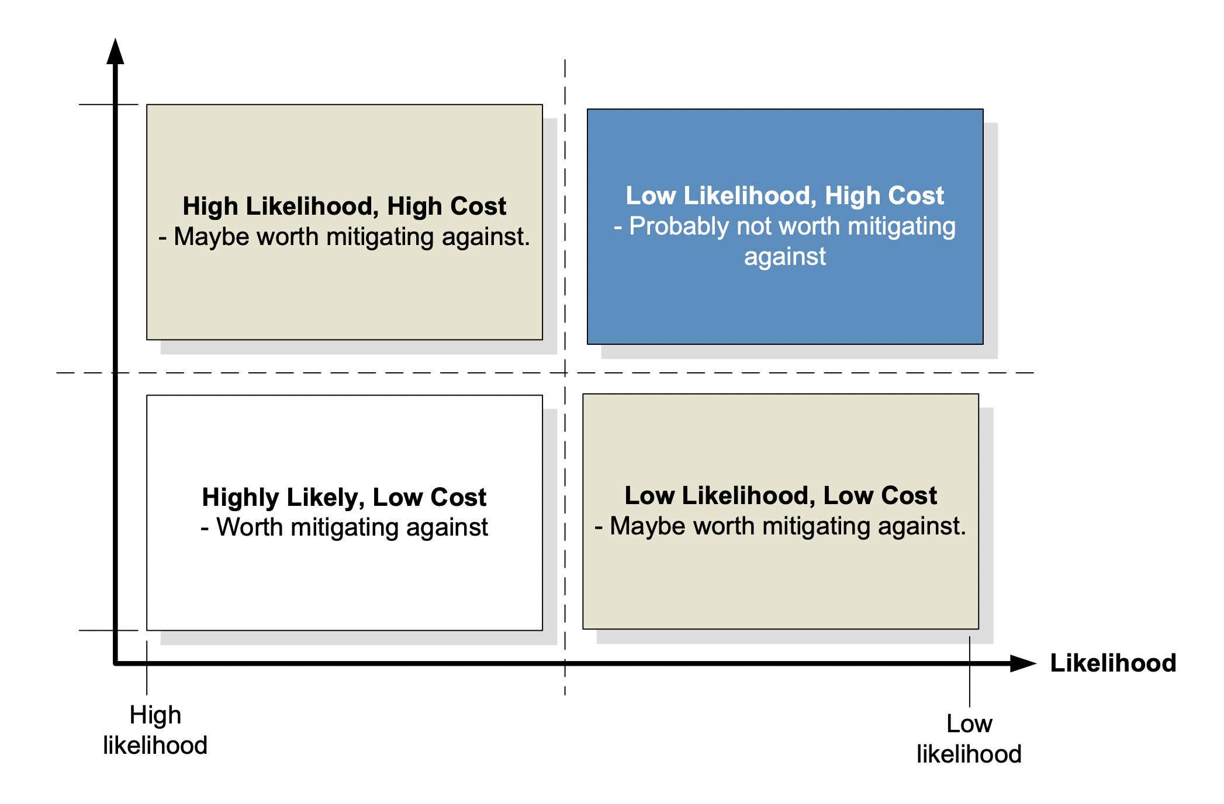
Risks, Costs and Benefits
ALE = AV x ARO
ALE – Annual Loss Expectancy.
AV – Asset Value

Slide 13
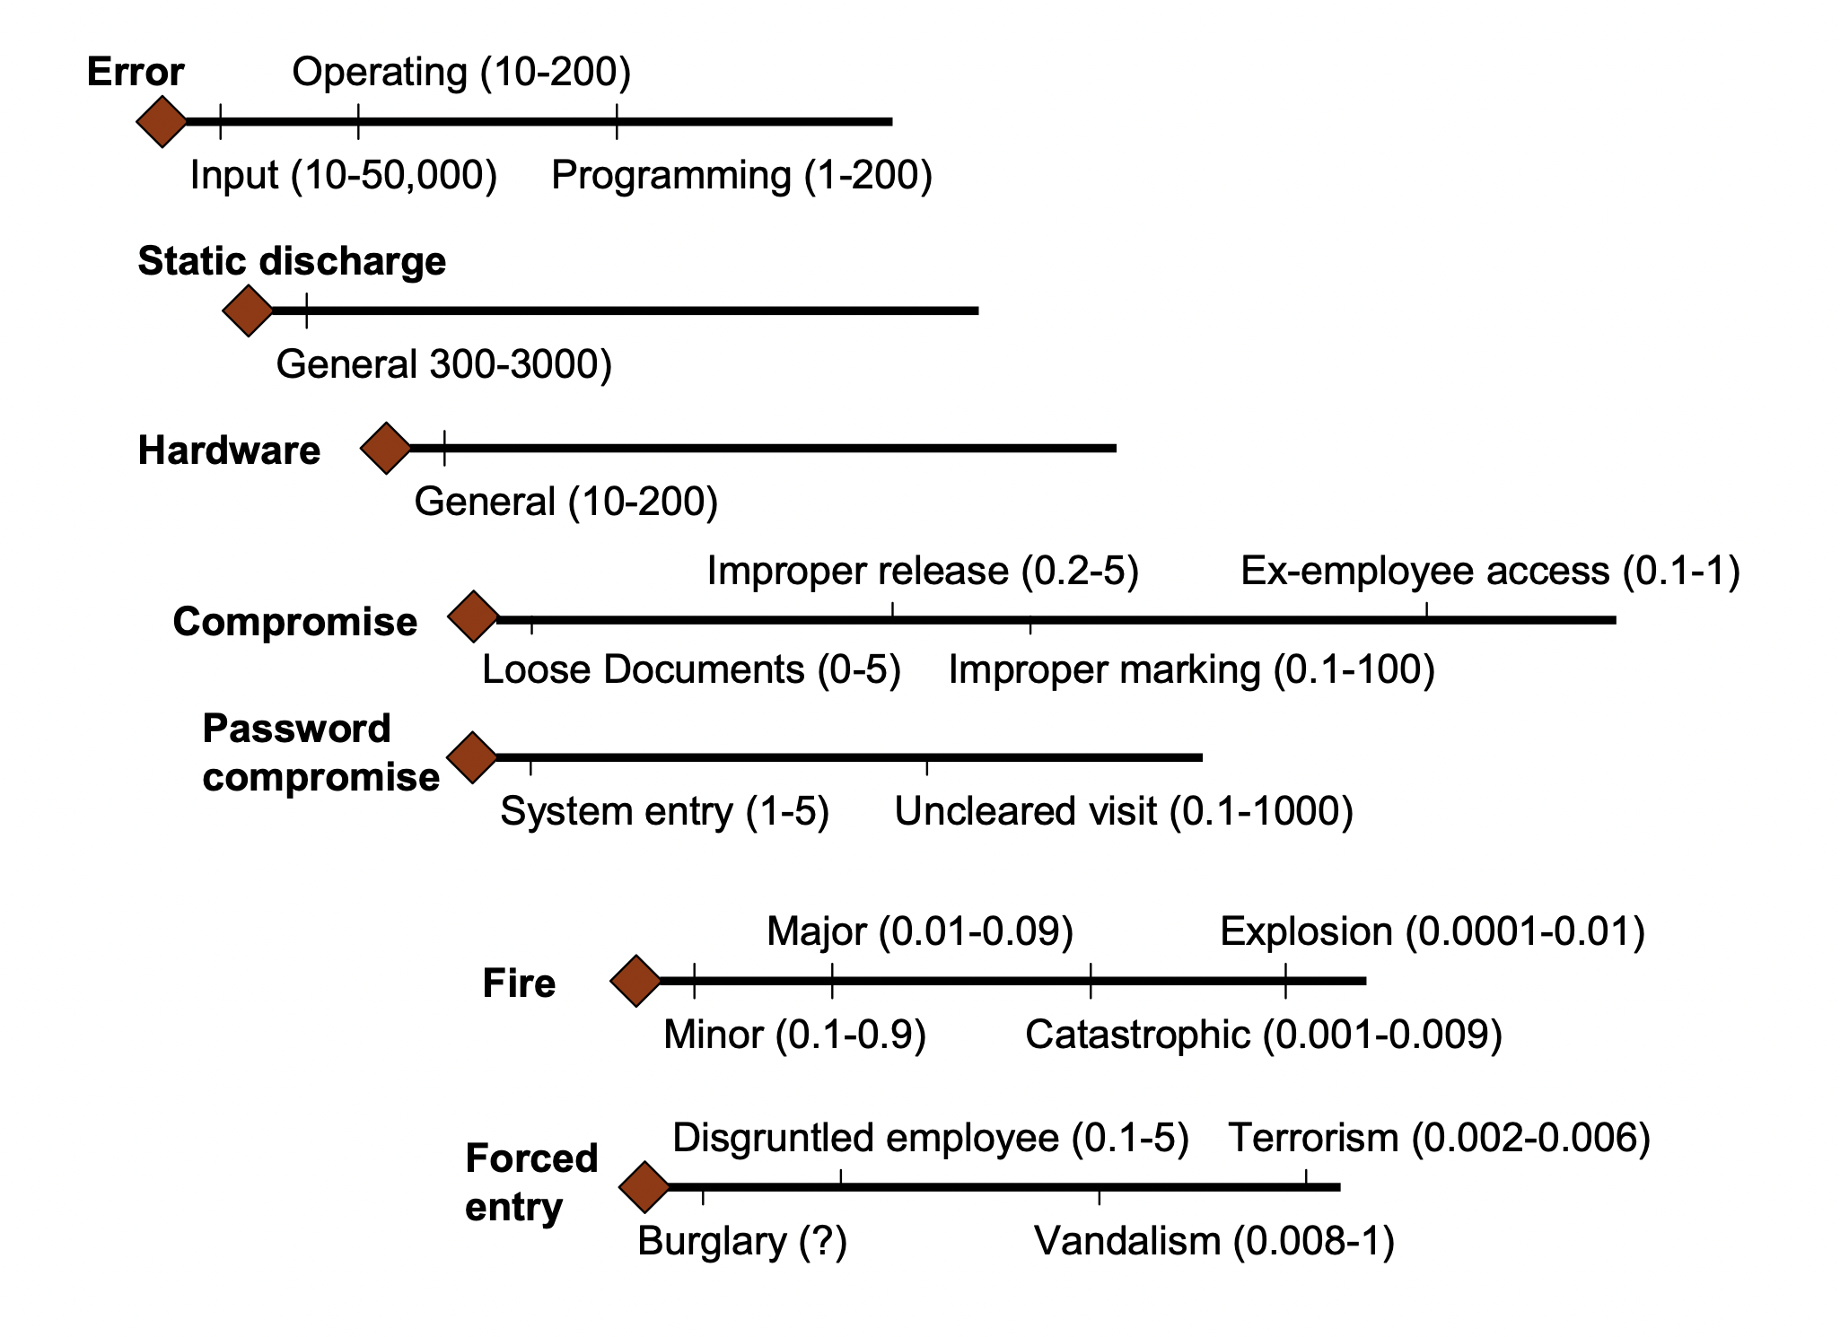
Risks, Costs and Benefits

Slide 14
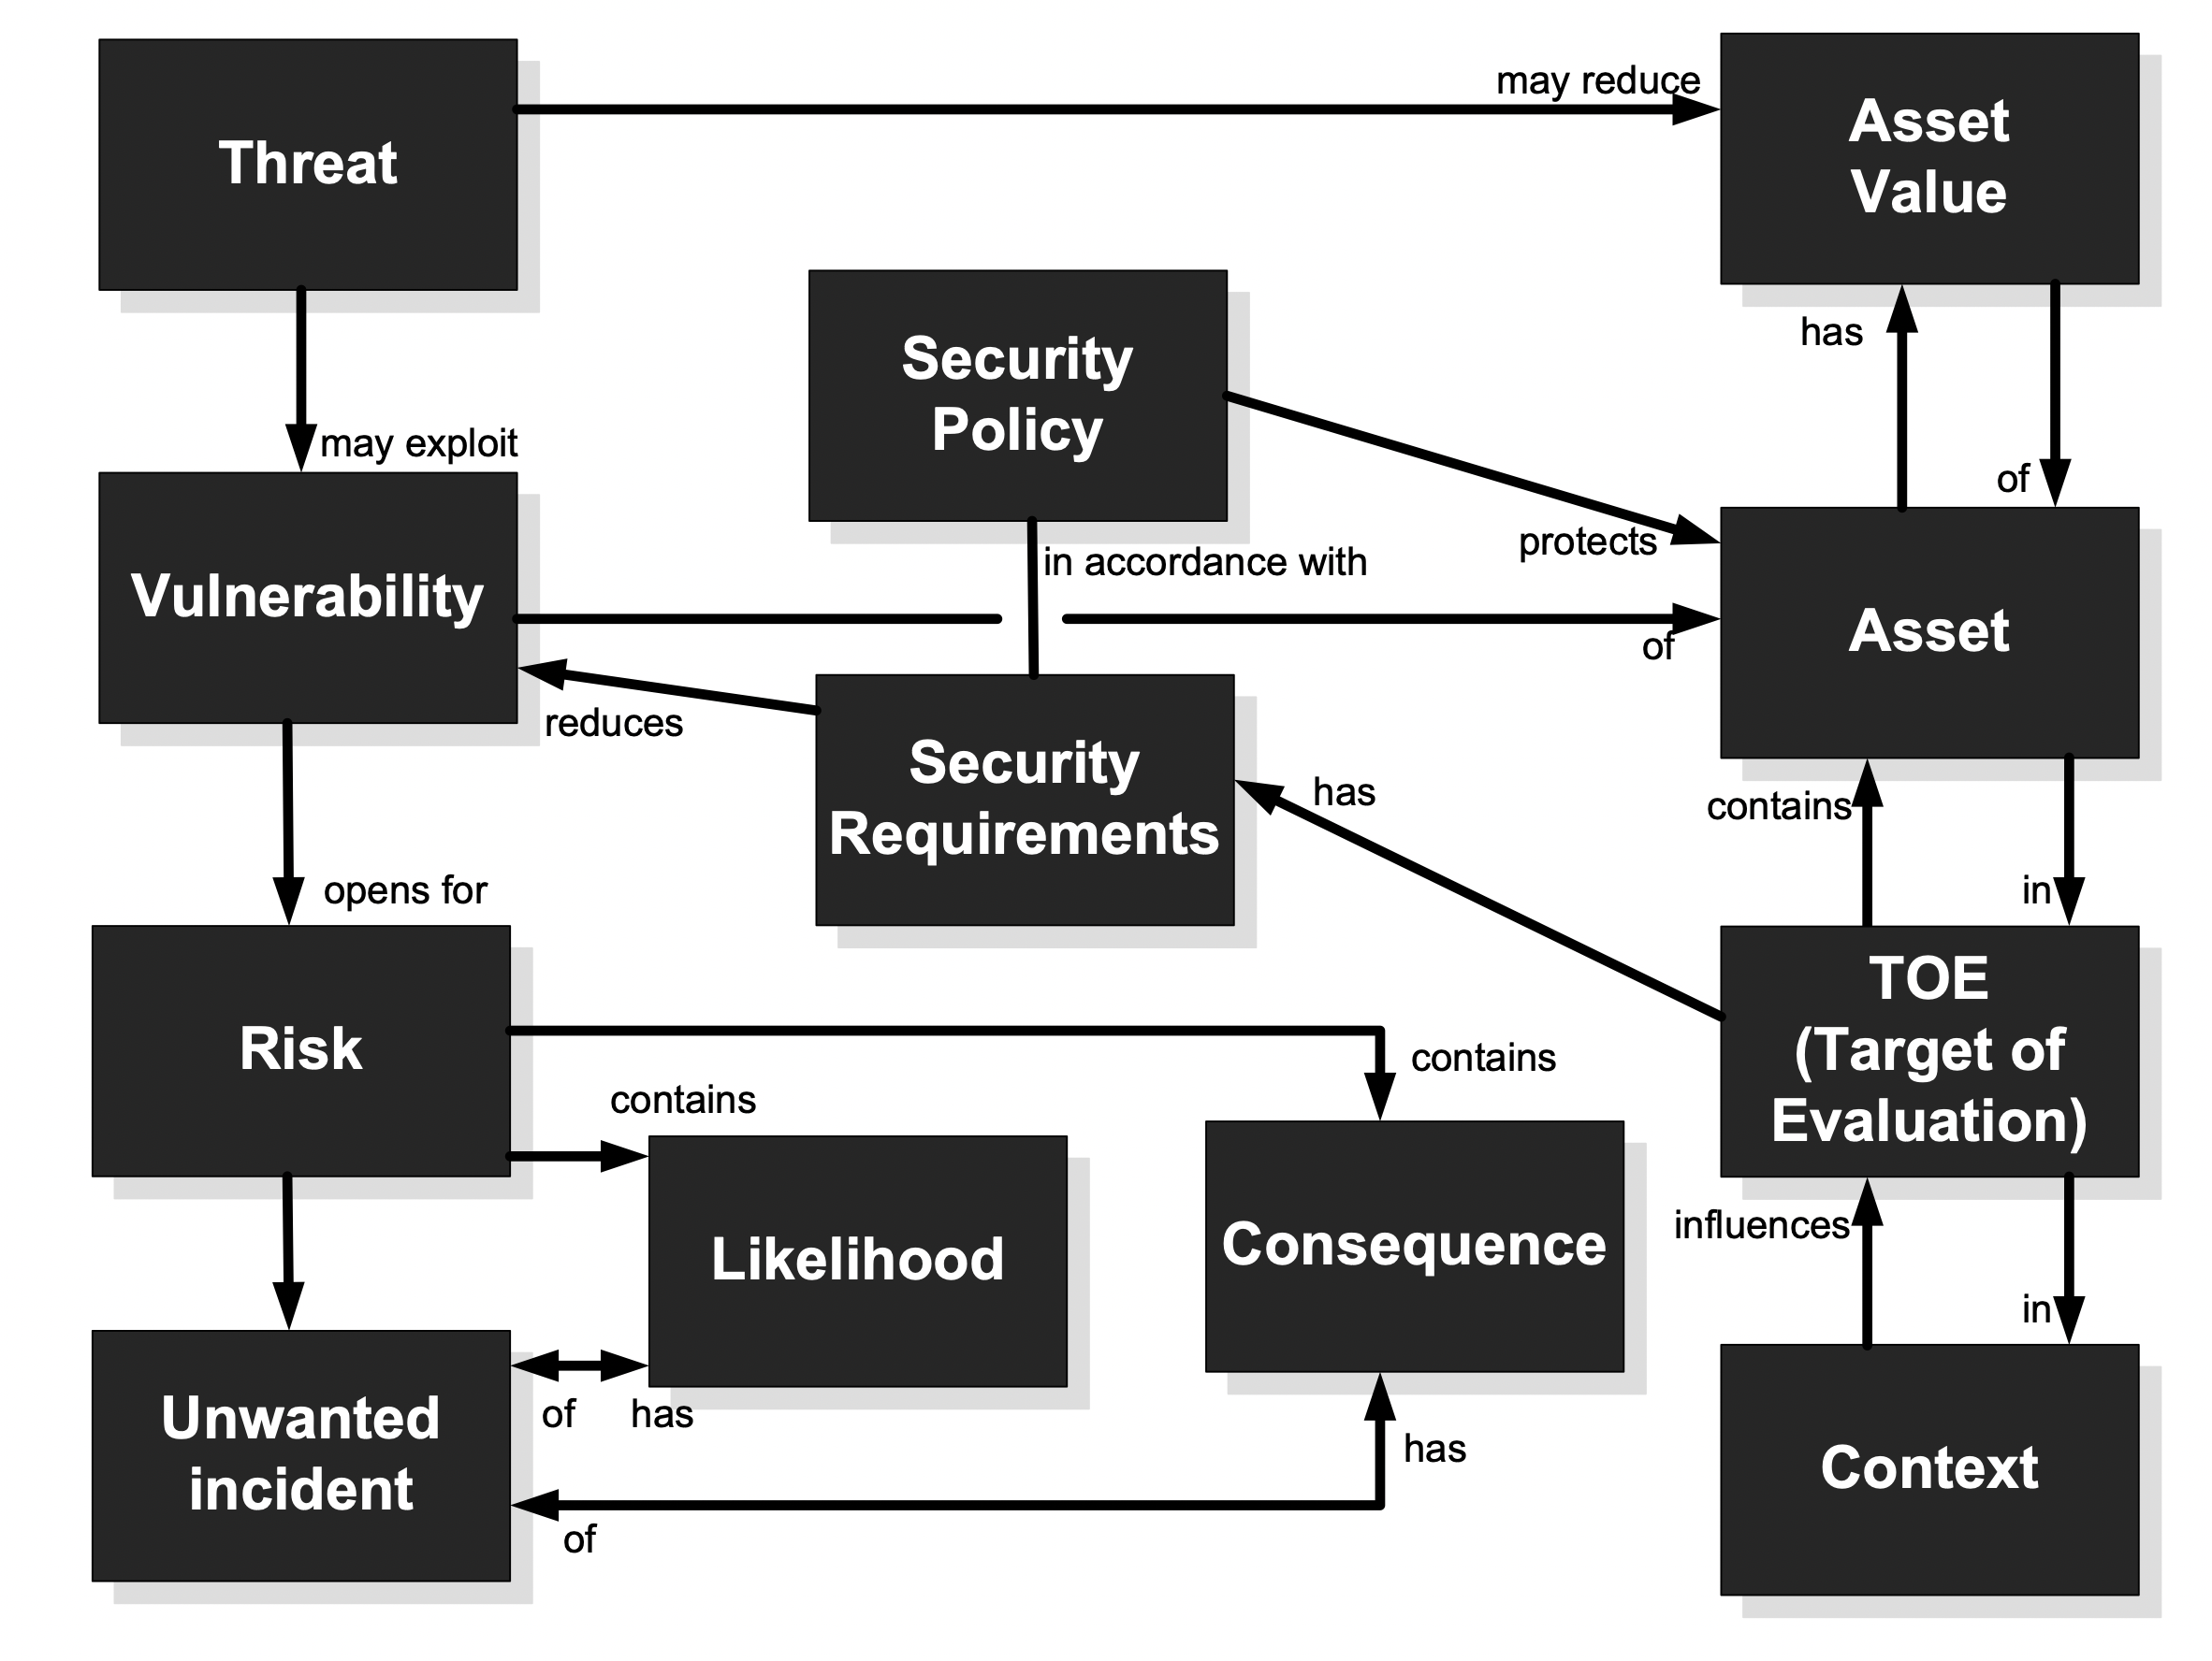
CORAS Ontology

Slide 15
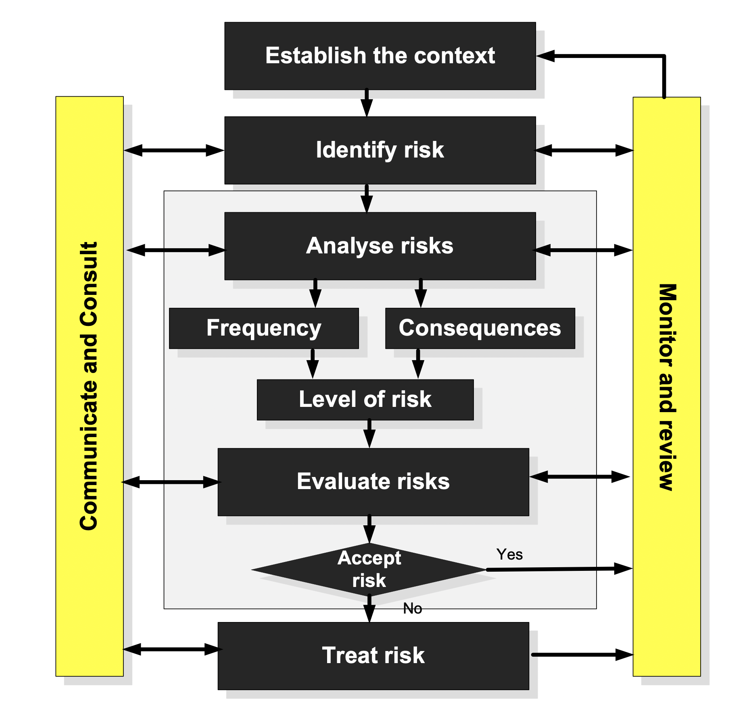
CORAS Risk Management

Slide 16
Kill Chain Model
“From bits to information”

Slide 17
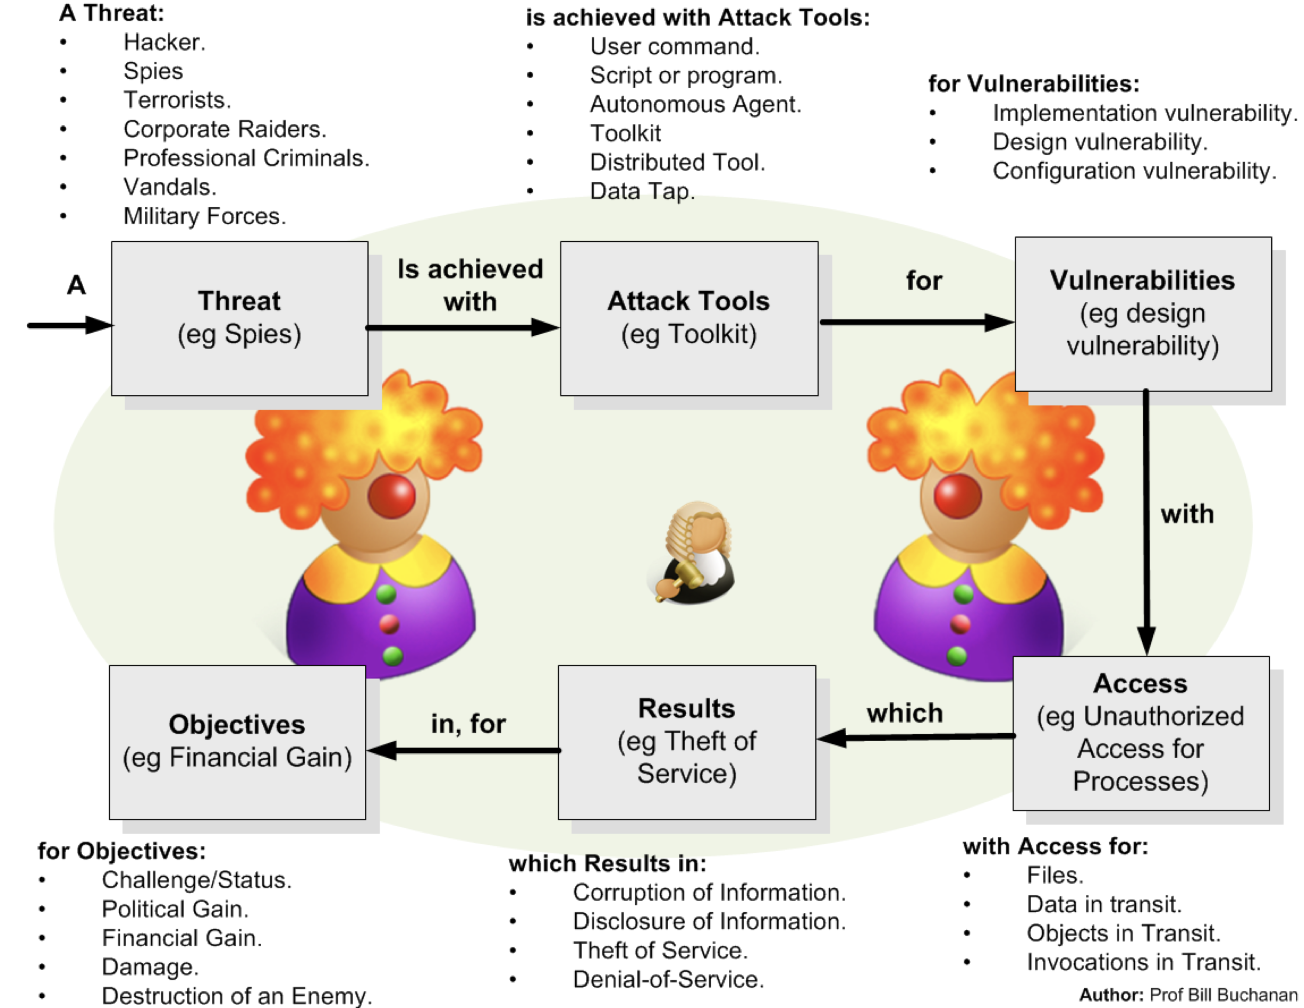
Incident Taxonomy

Slide 18
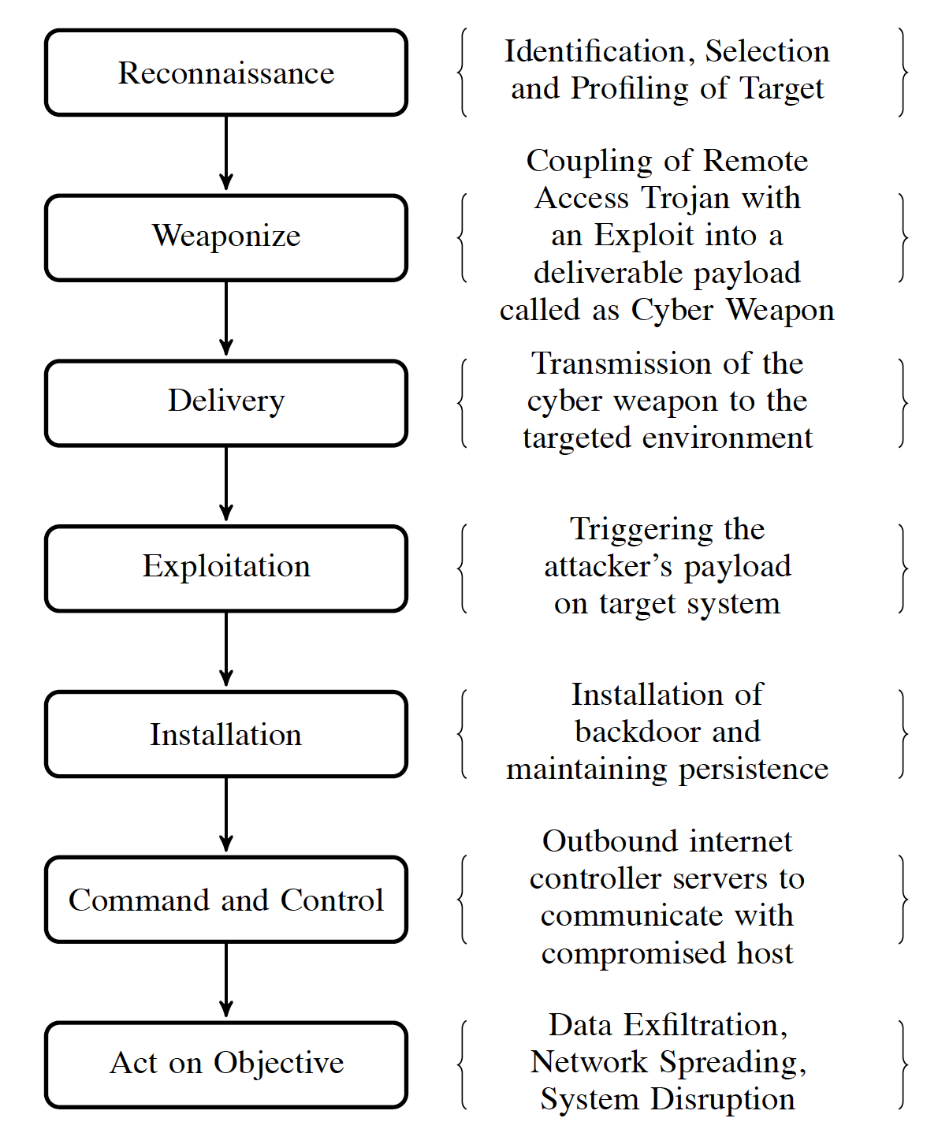
Kill Chain Model

Slide 19
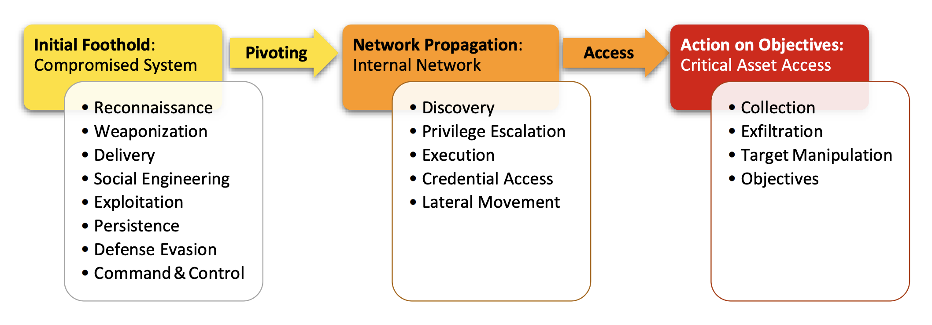
Unified Kill Chain Phases

Slide 20
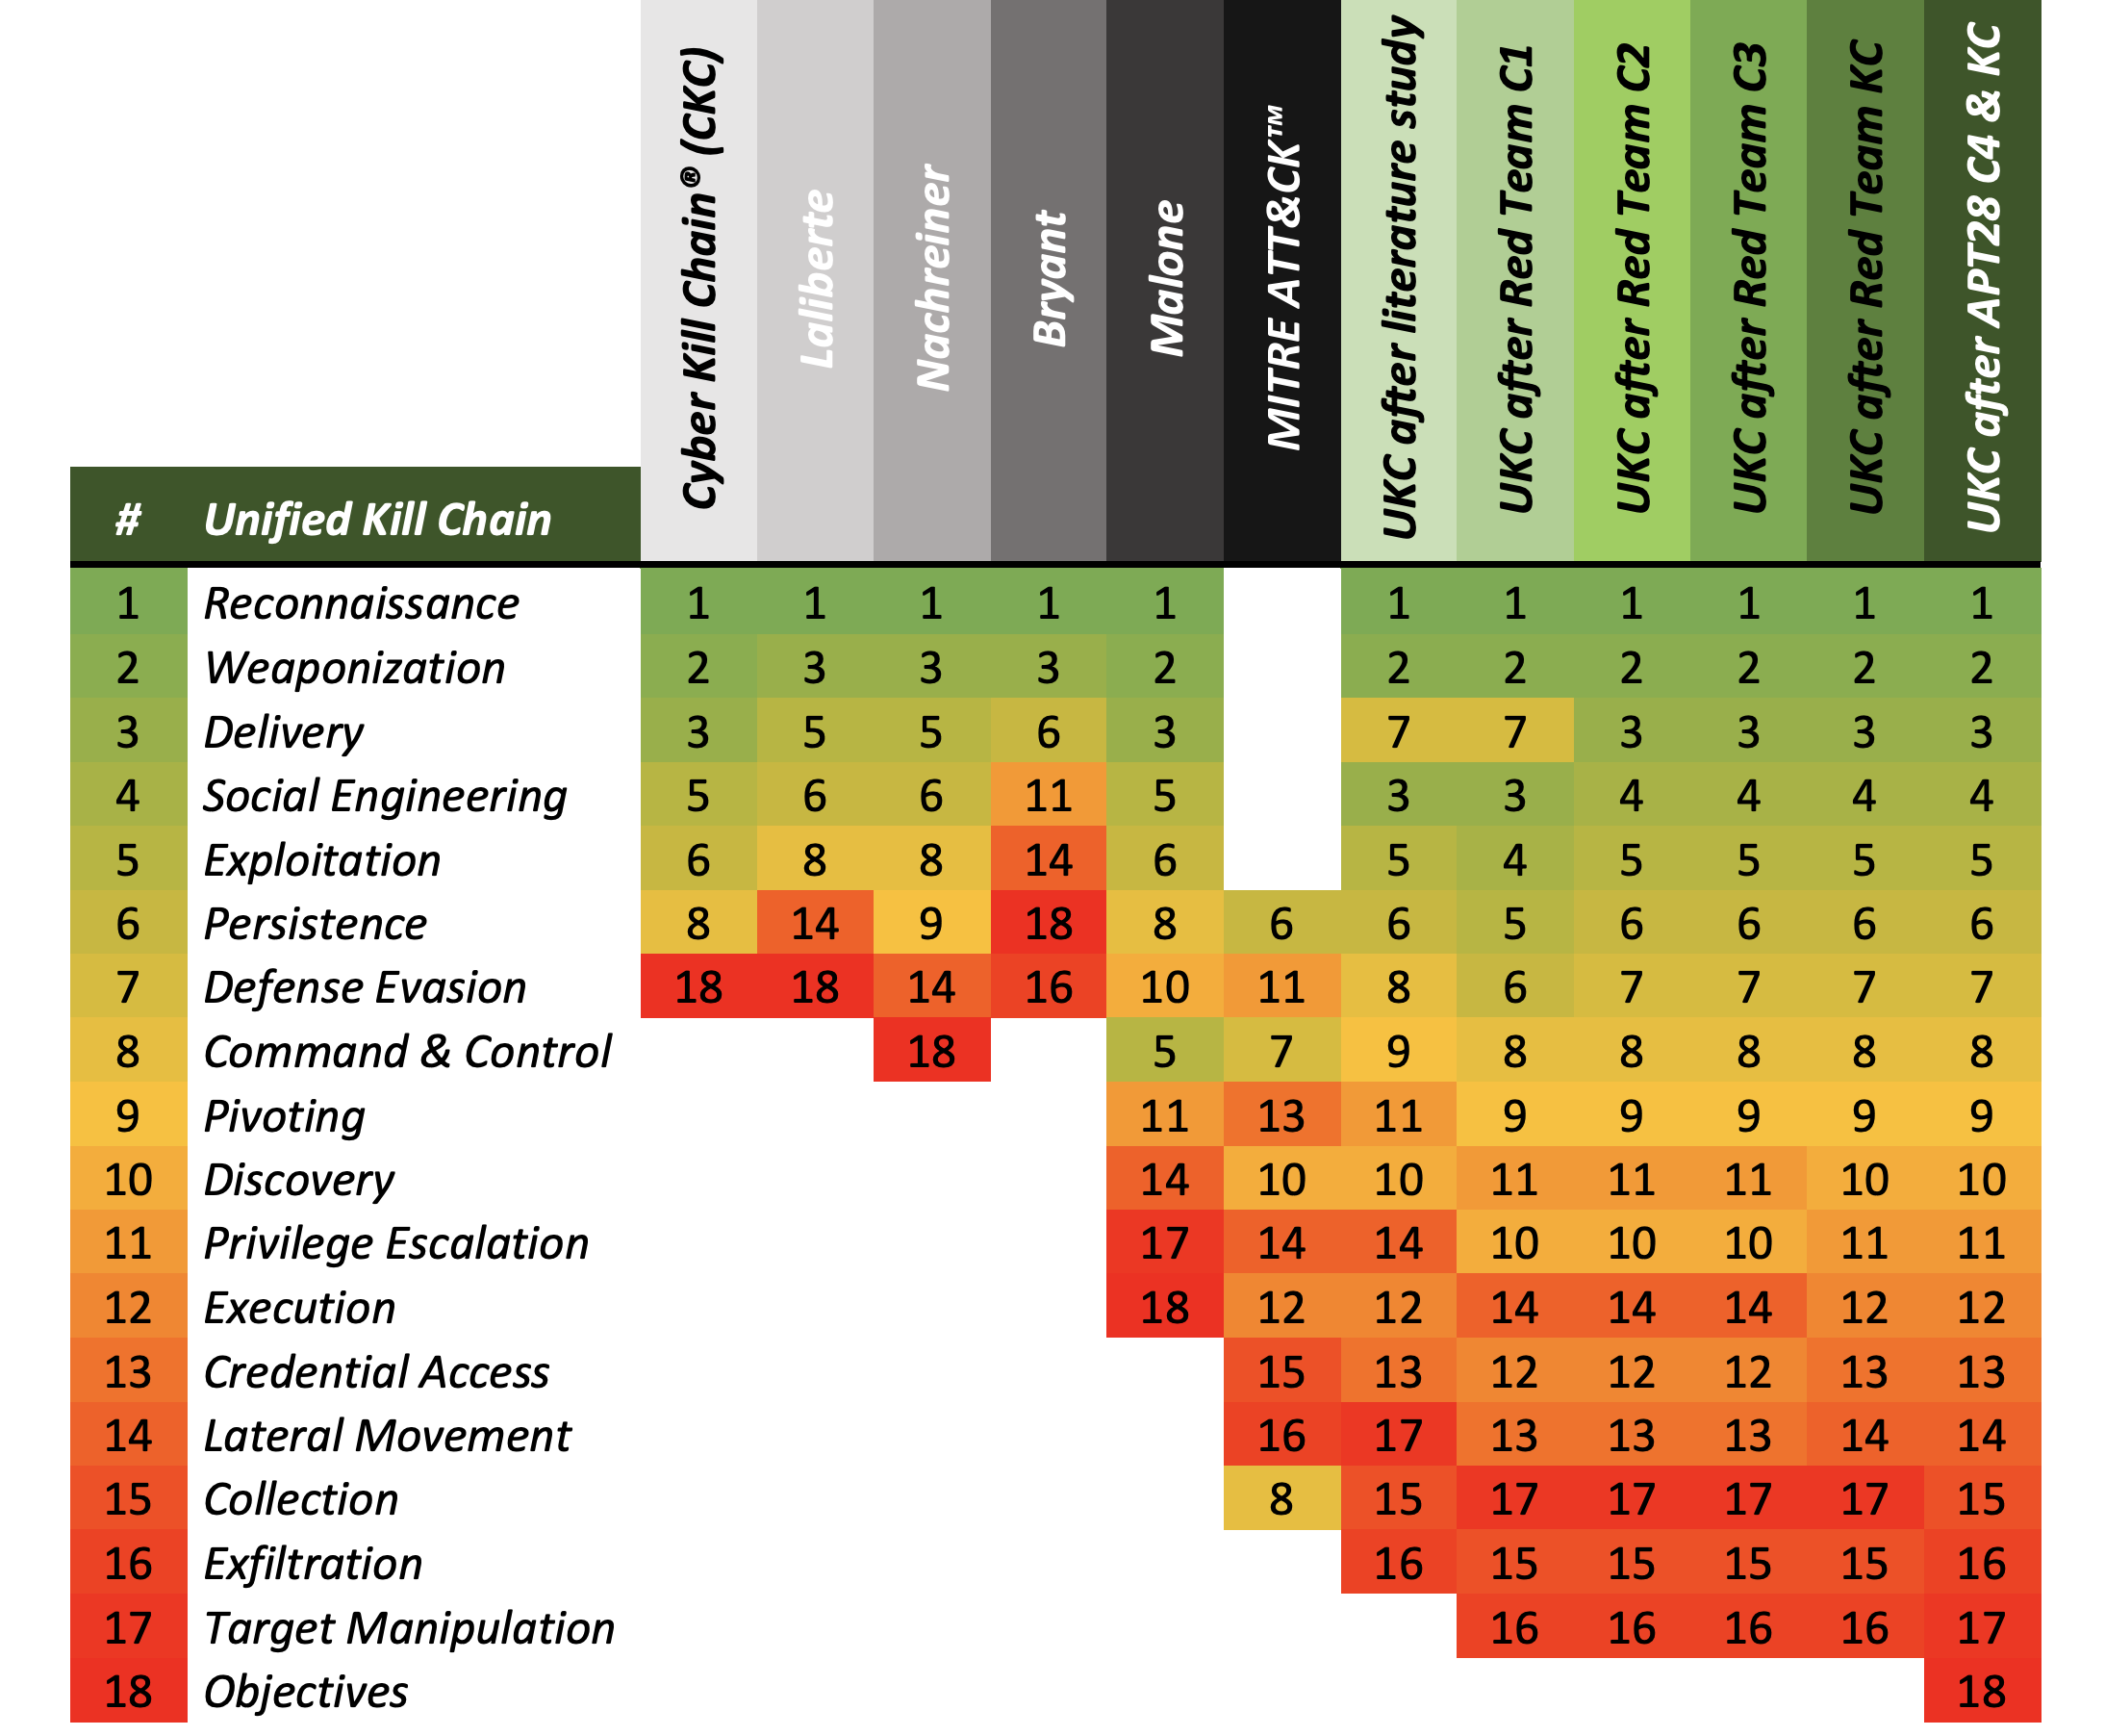
Unified Kill Chain Model

Slide 21
Defence Mechanisms
“From bits to information”

Slide 22
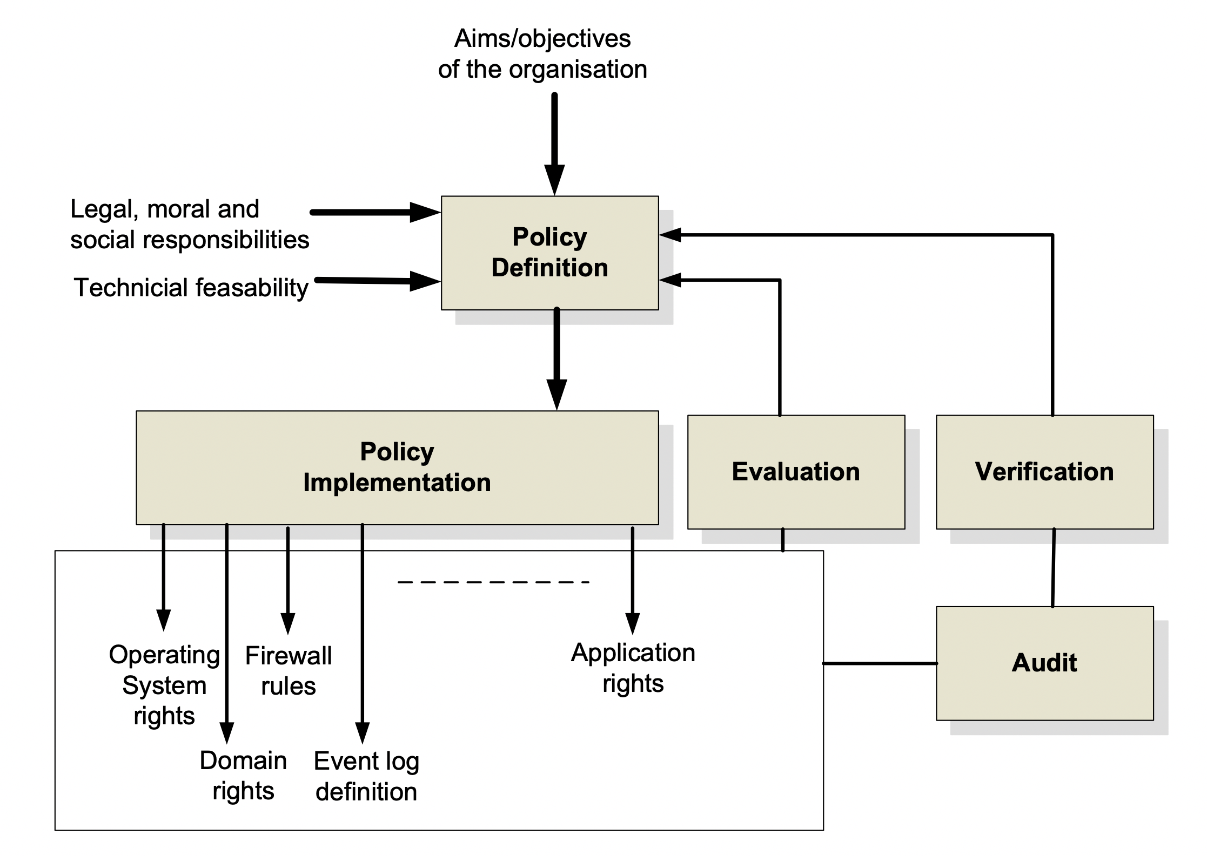
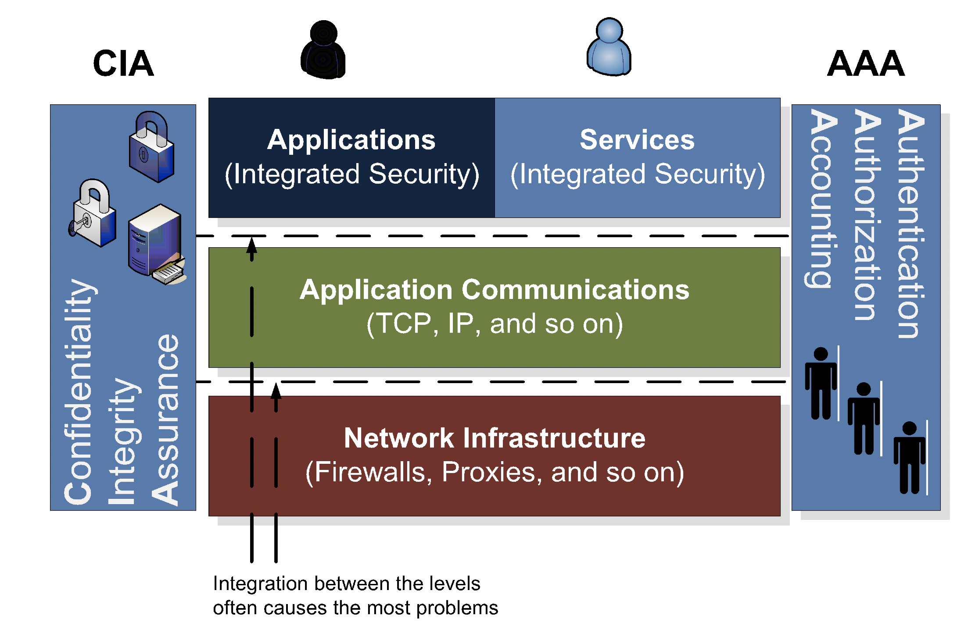
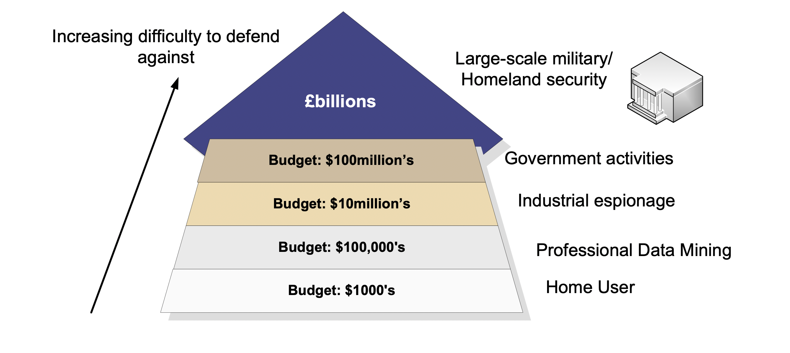
Types of intelligence
Deter. This is where the system is designed and implemented in order to initially deter intruders from attacking the system in the first place.
Log. This is a key element in modern systems which requires some form of logging system. It is important that the data that is logged does not breach any civil liberties, and is in a form which can be used to enhance the future security of the system.
Detect. This is where detection agents are placed within the network to detect intrusions, and has methods of tracing the events that occurred in an intrusion, so that it can be used either in a forensic computing investigation, and/or to overcome a future intrusion. Organisations often have many reasons for detecting network traffic.
Protect. This is where policies are created which protect systems, users and data against attack, and in reducing this potential damage. A key element of this is to protect them against accidental damage, as accidental damage is often more prevalent than non-accidental damage.
React. This is where a policy is defined which reacts to intrusions, and defines ways to overcome them in the future. Often organisations do not have formal policies for this type of activity, and often rely on ad-hoc arrangements, where the method of reacting to a security breach is created after the event.
Recover. This is where policies are defined to overcome any system damage, whether it is actual physical damage, the abuse of users; or the damage to data.
Audit/verify. It is important that the security policy allows for auditing and for the verification that it achieves its requirements.

Slide 23
Defence in Depth
“From bits to information”

Slide 24
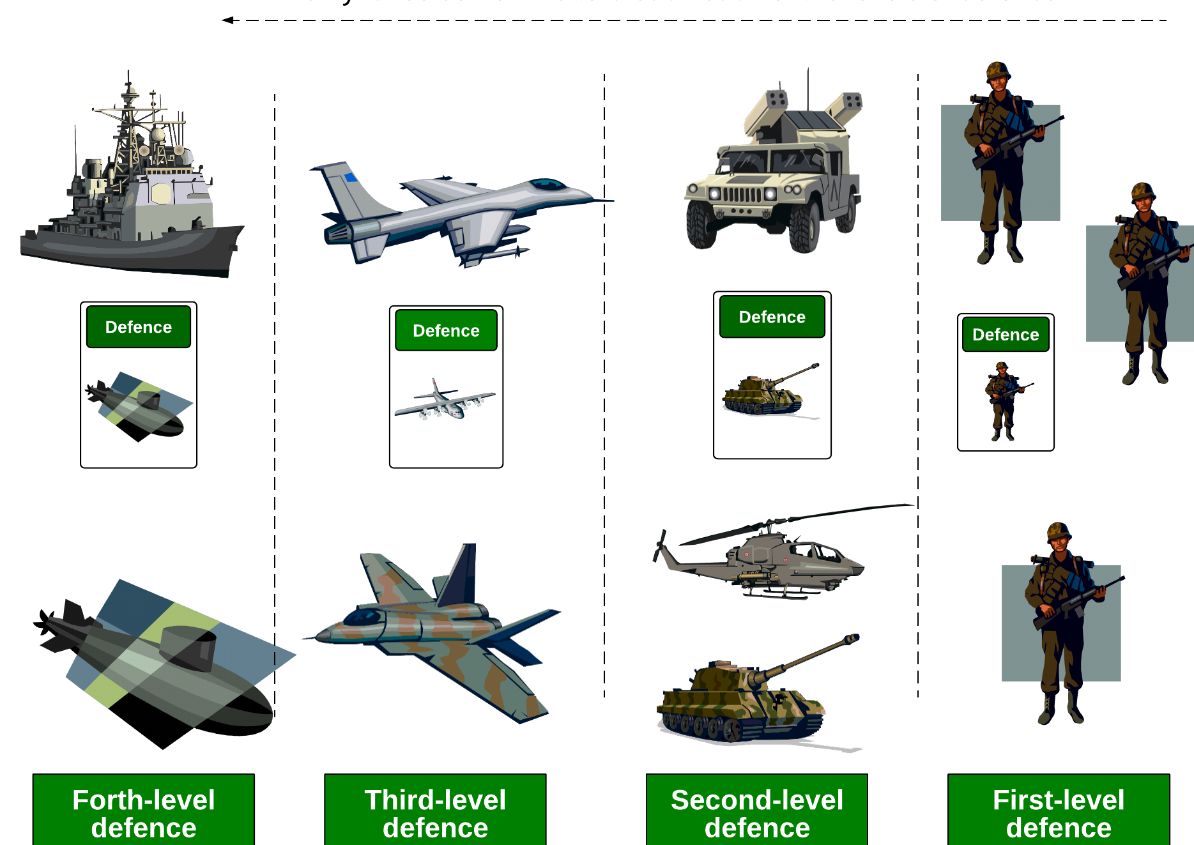
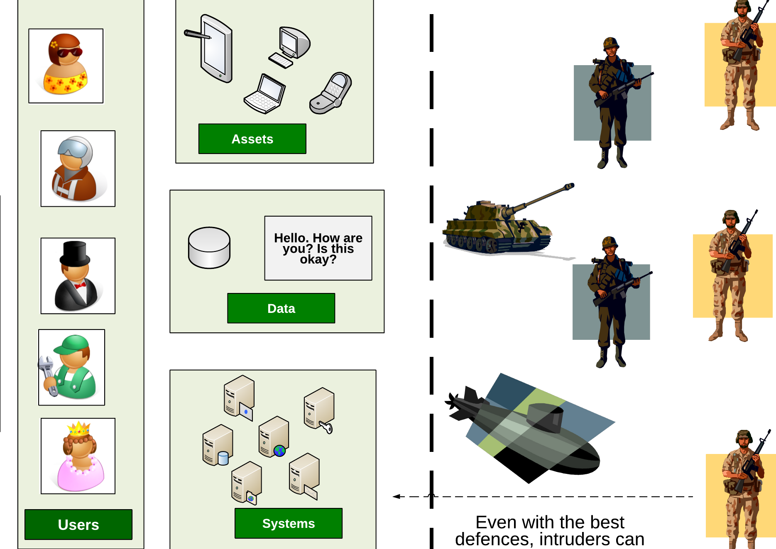
Defence in depth

Slide 25
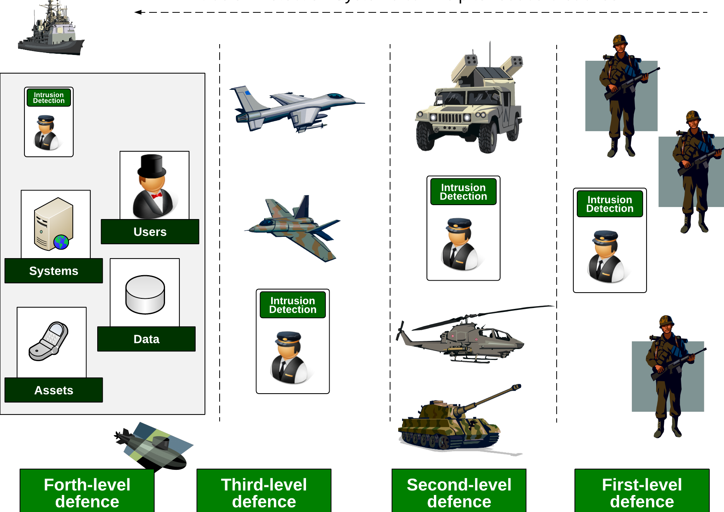
Defence in depth

Slide 26
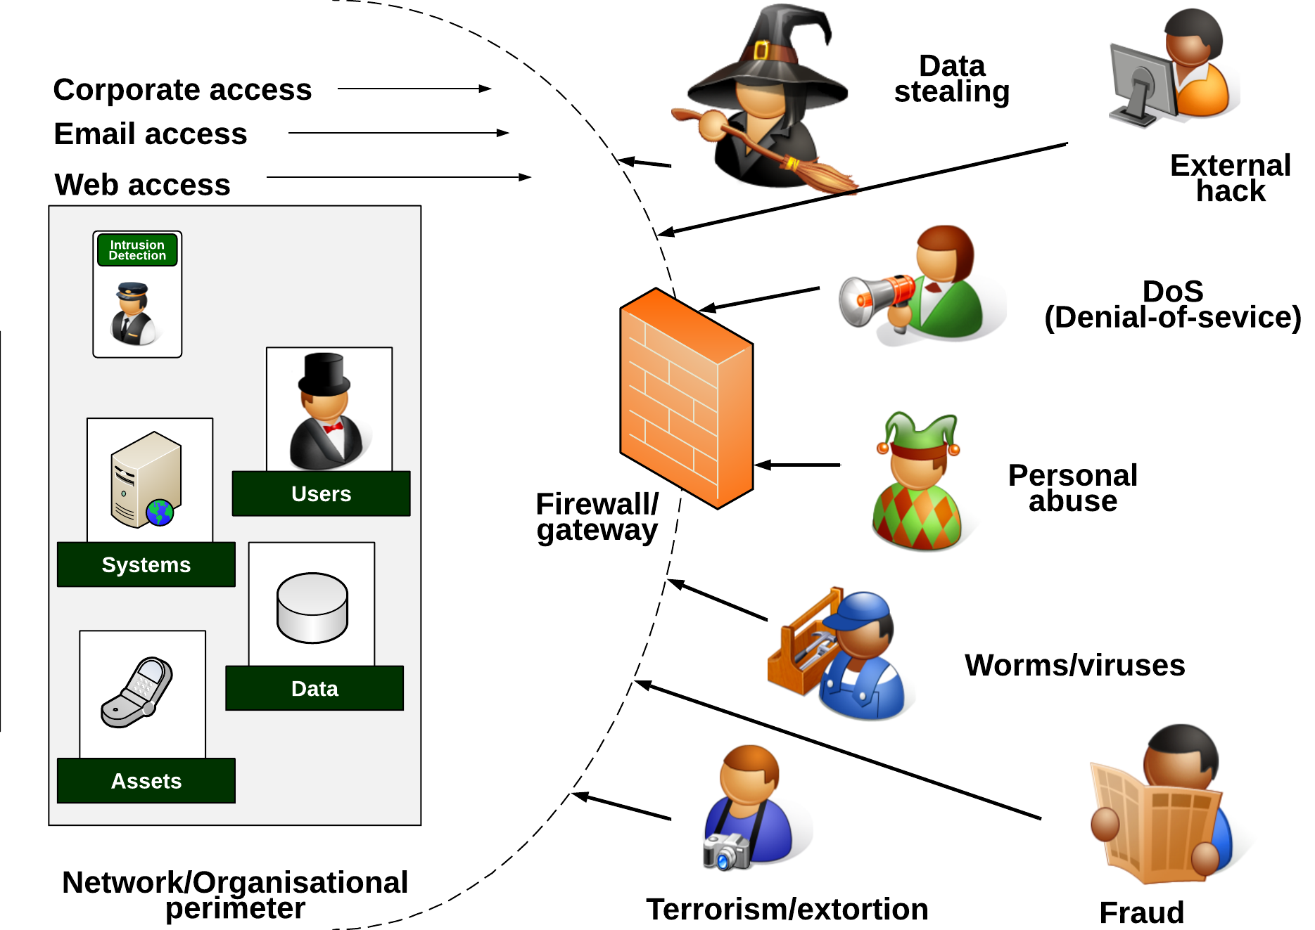
Threats

Slide 27
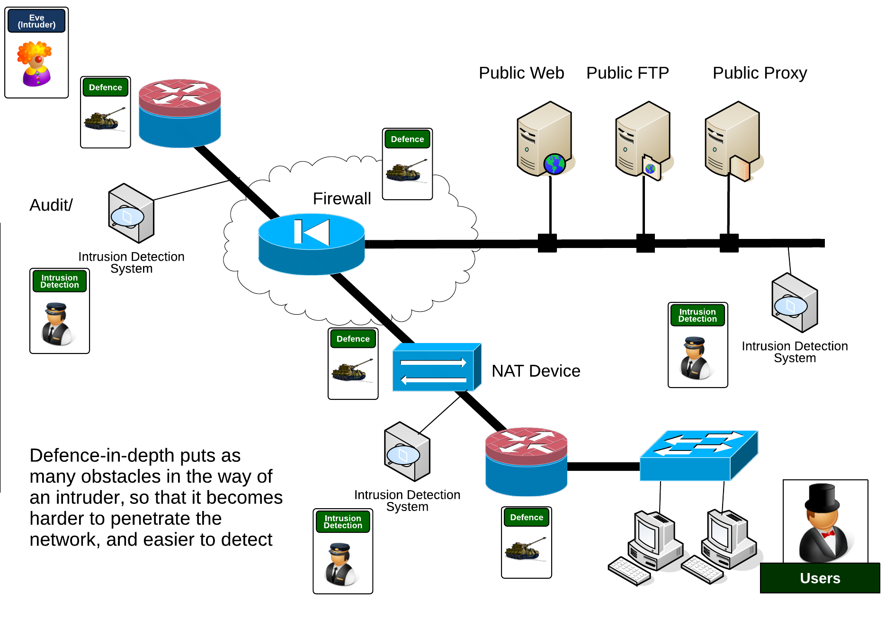
Defence in depth

Slide 28
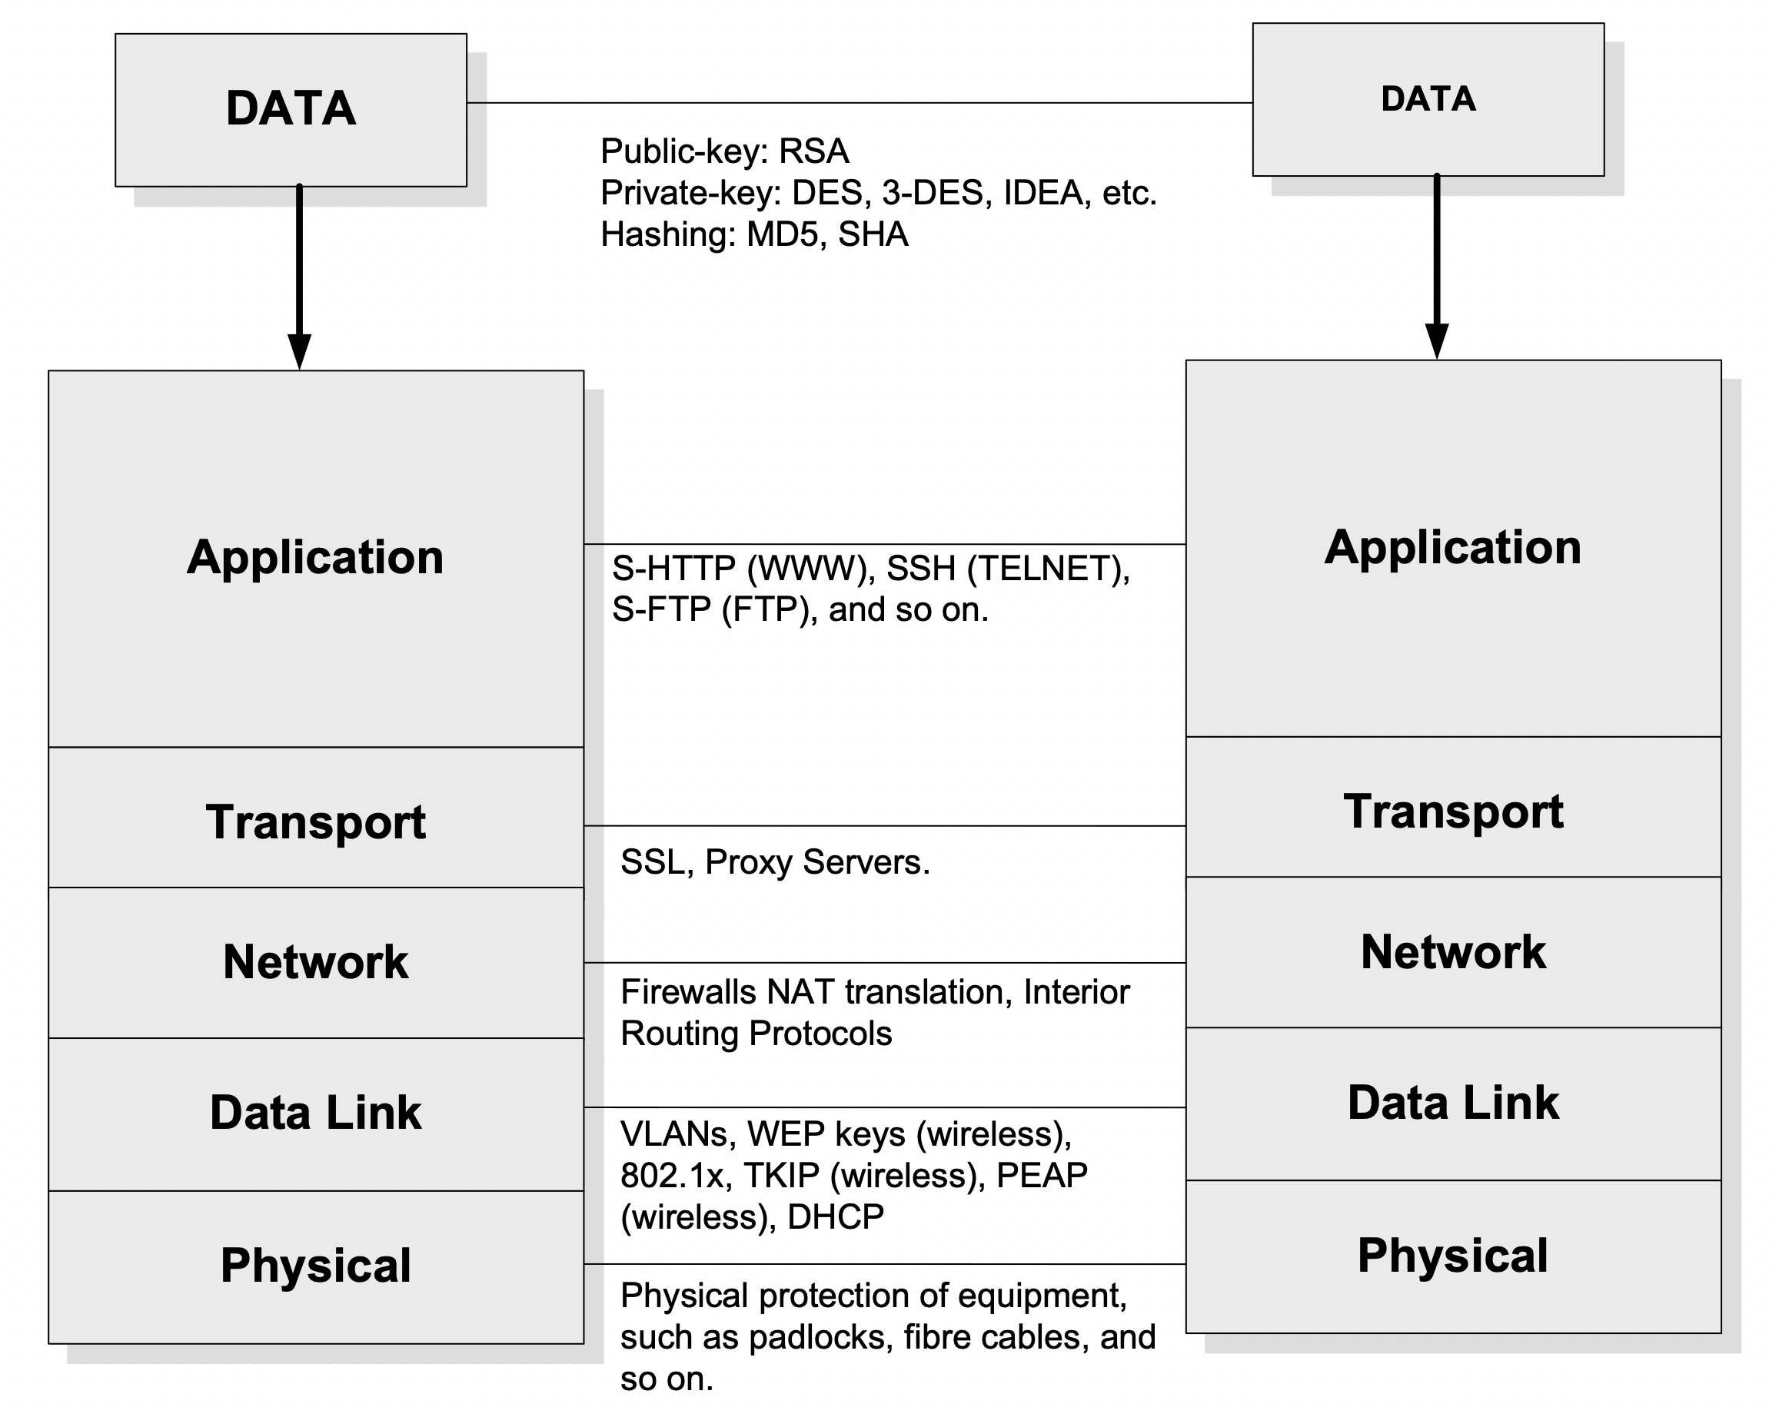
Layered Model

Slide 29
Network Security
“From bits to information”

Slide 31
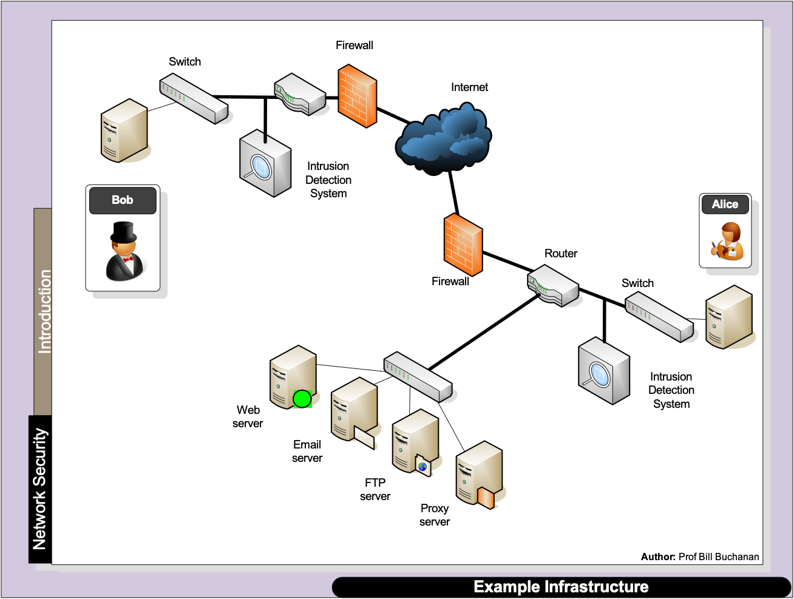
Layered Model

Slide 32
Layered Model

Slide 33
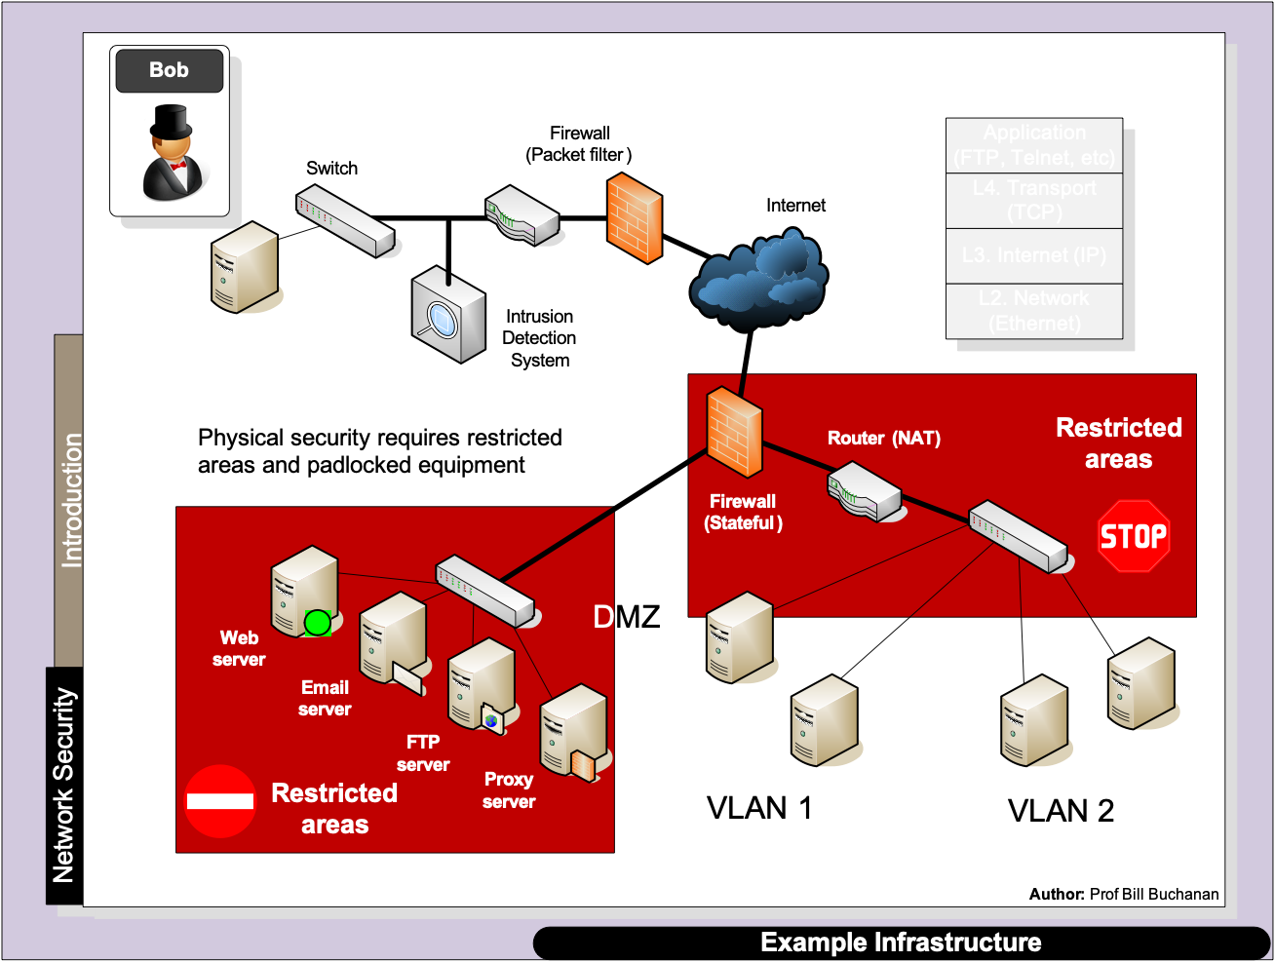
Layered Model

Slide 34
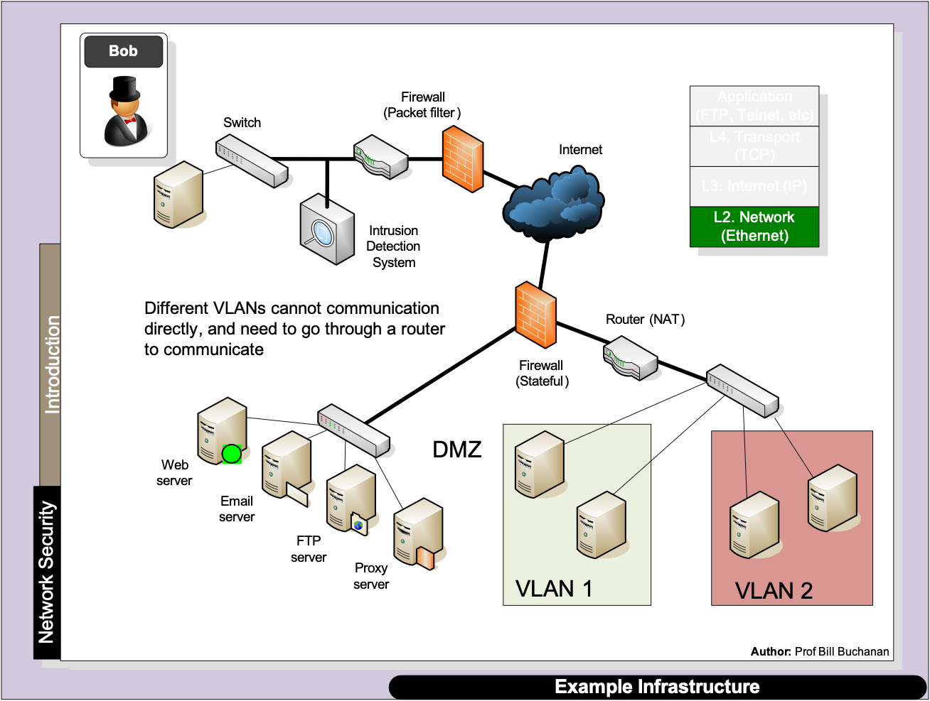
Layered Model

Slide 35
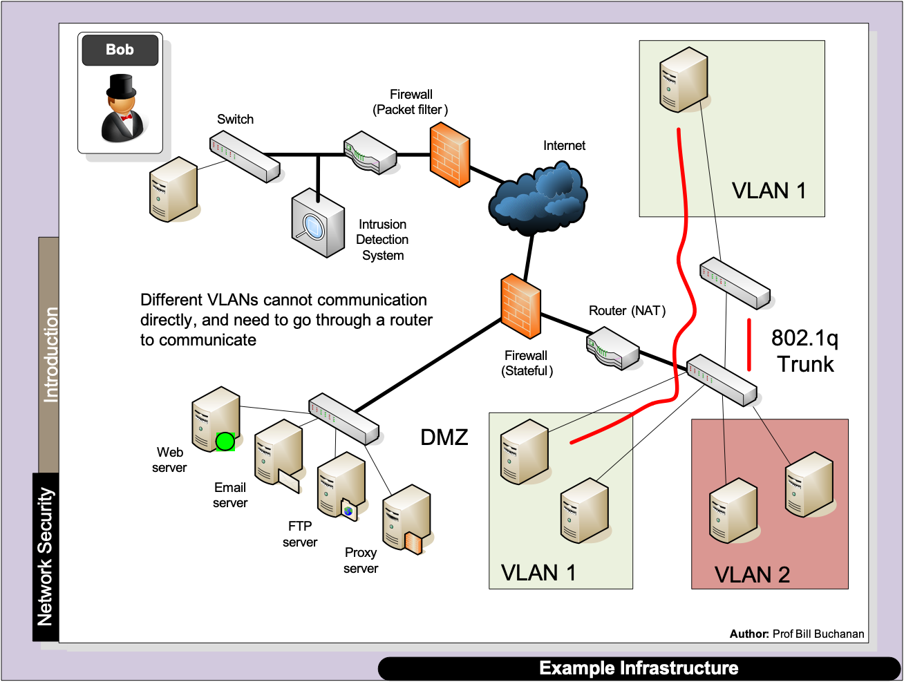
Layered Model

Slide 36
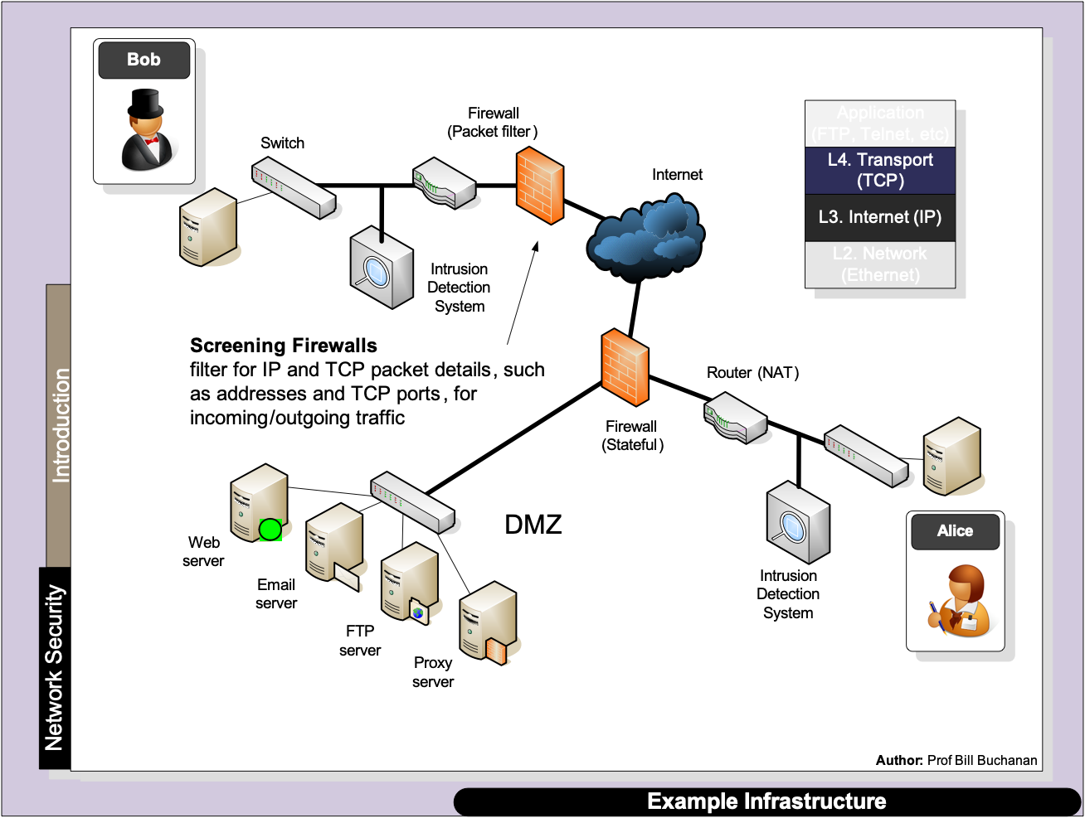
Layered Model

Slide 37
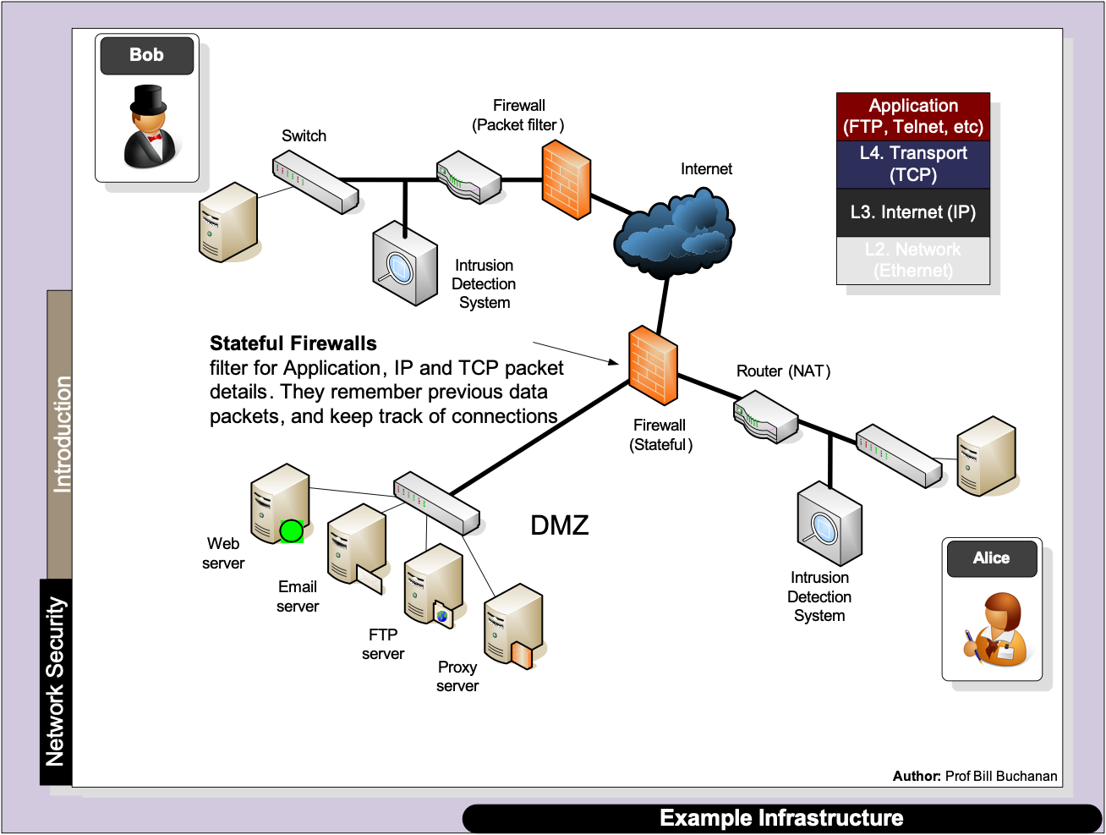
Layered Model

Slide 38
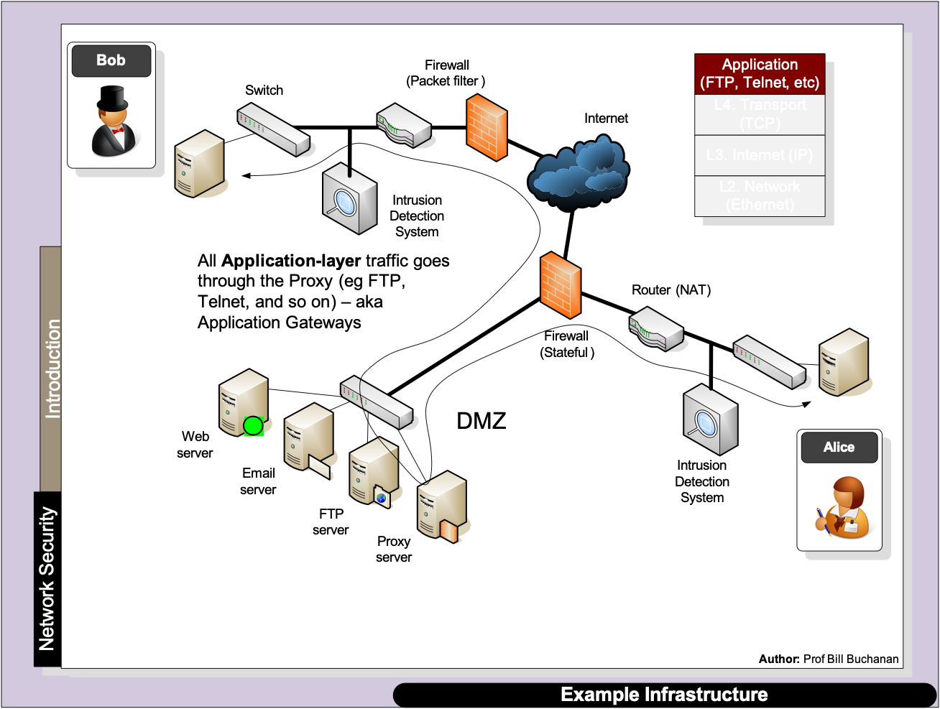
Layered Model

Slide 39
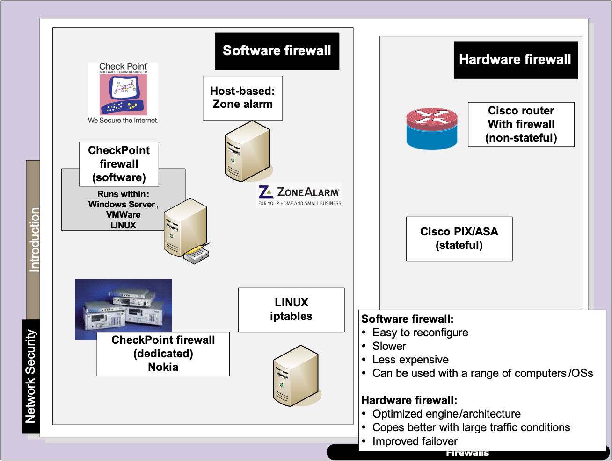
Layered Model

Slide 40
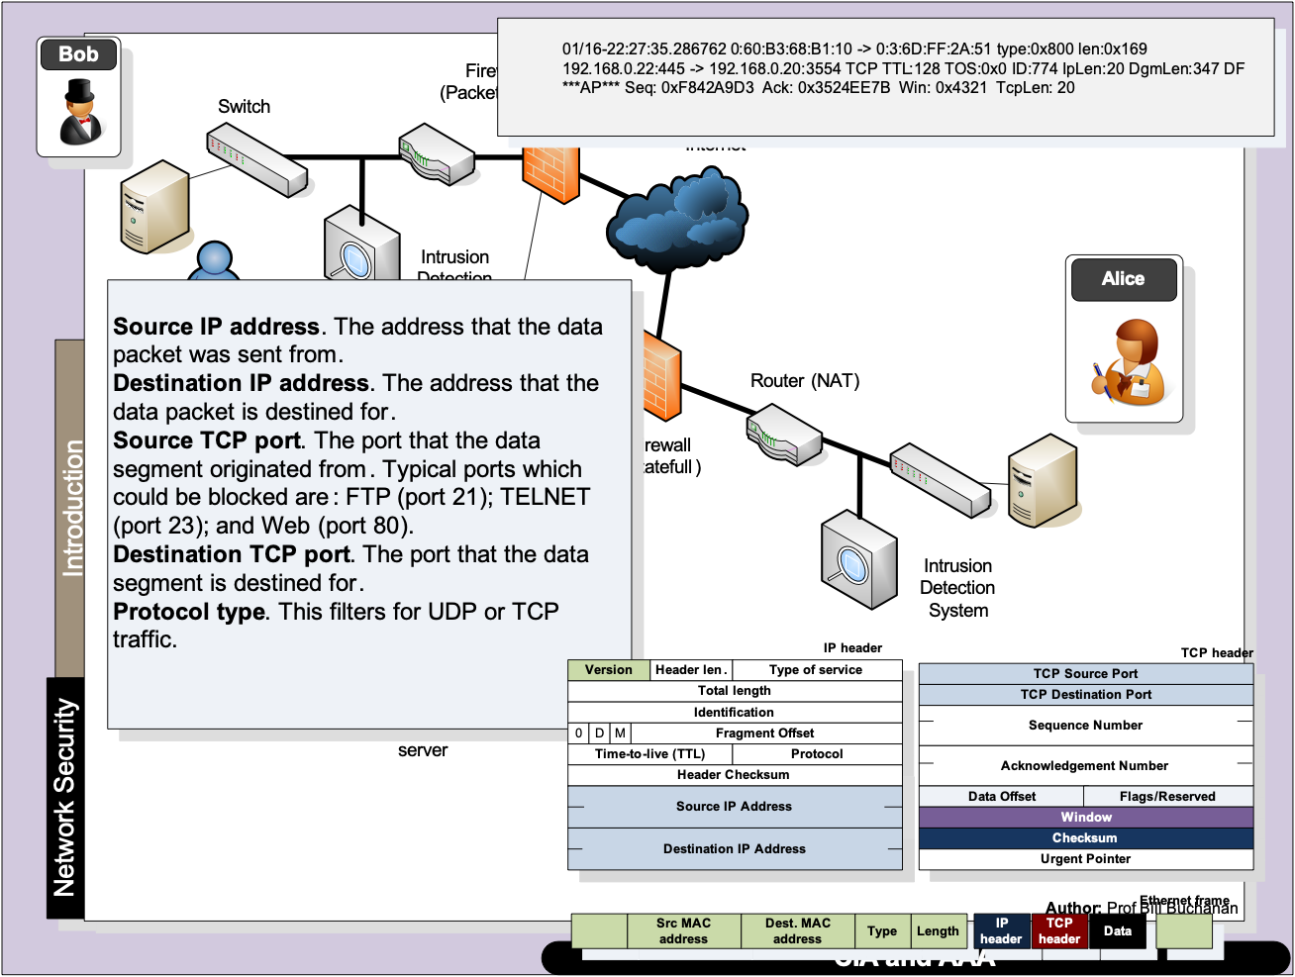
Layered Model

Slide 41
NAT
“From bits to information”

Slide 42
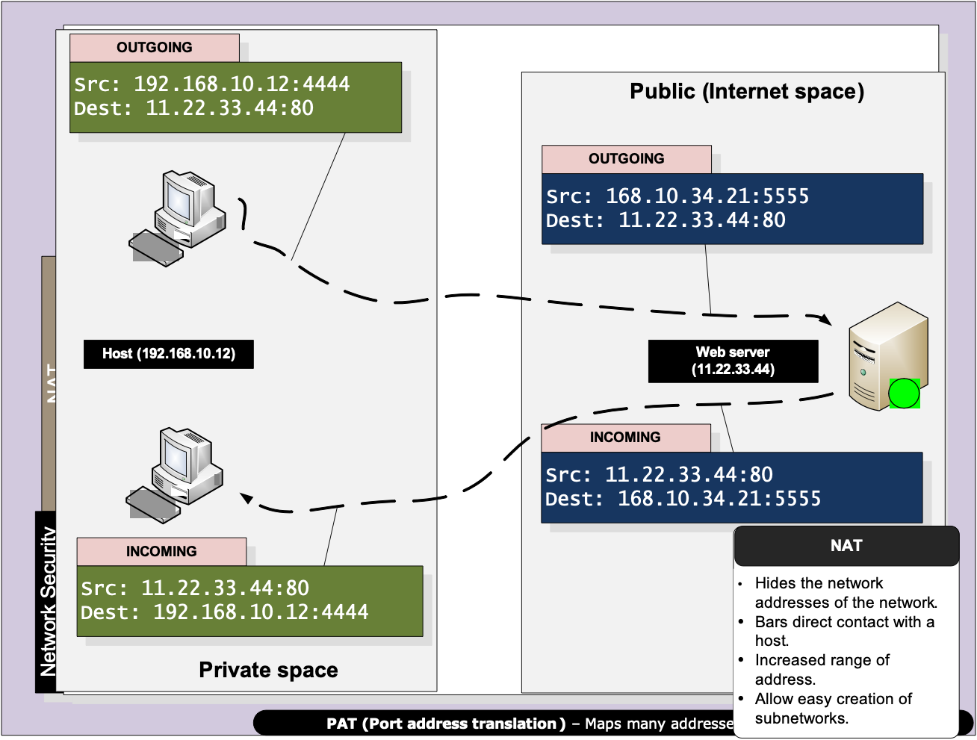
Layered Model

Slide 43
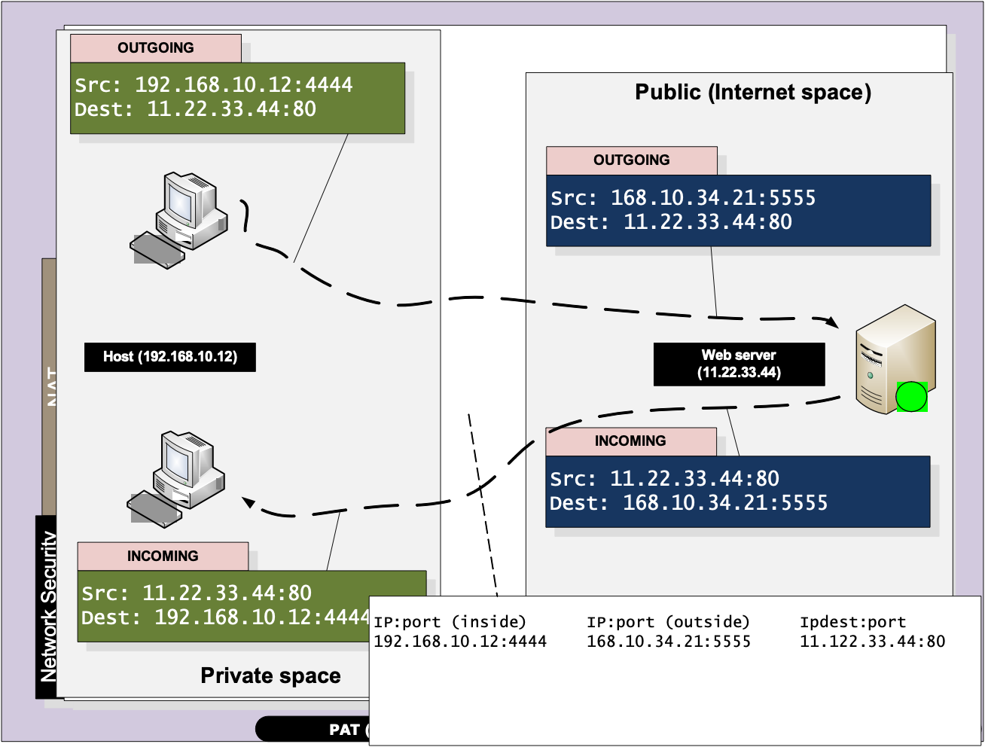
Layered Model

Slide 44
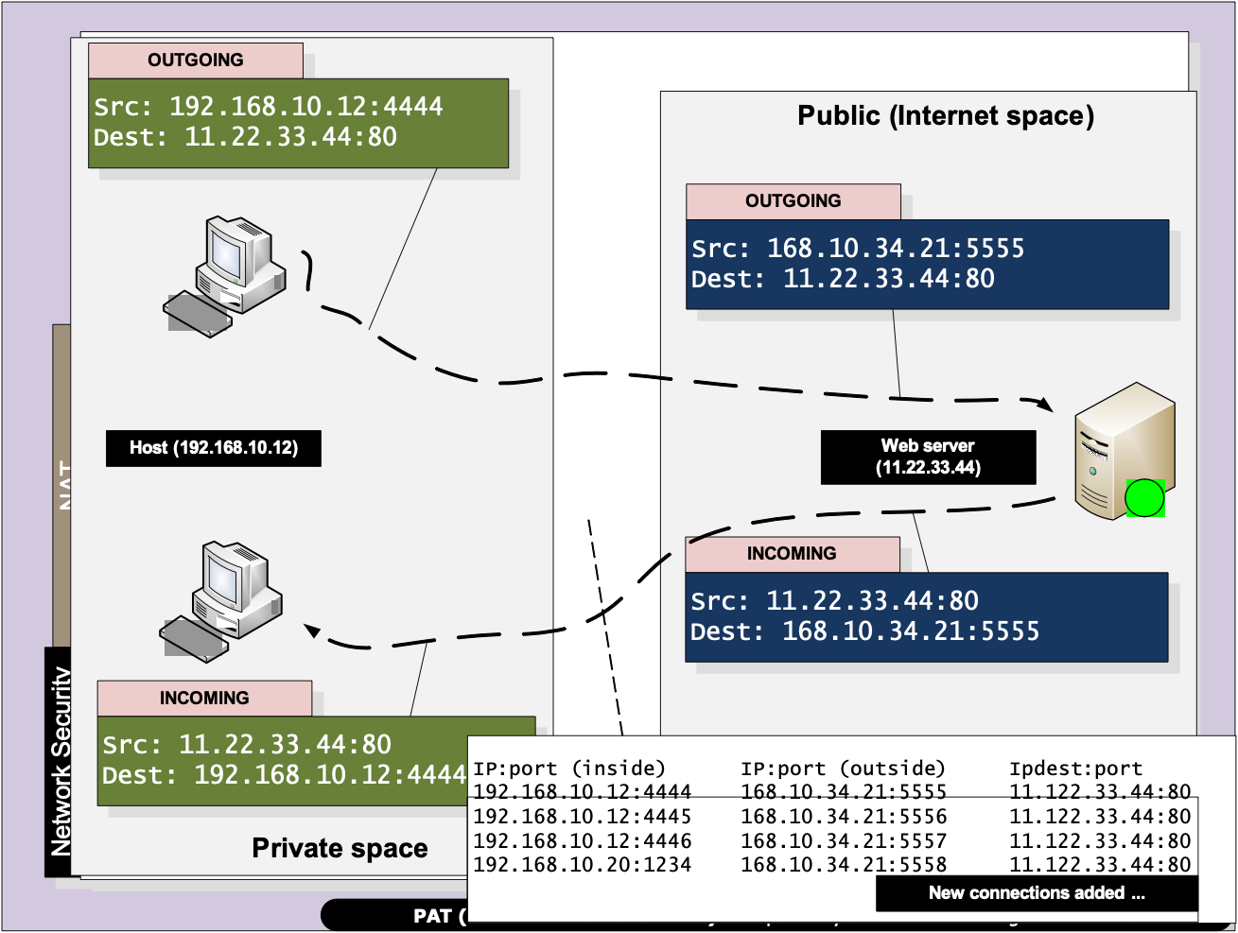
Layered Model

Slide 45
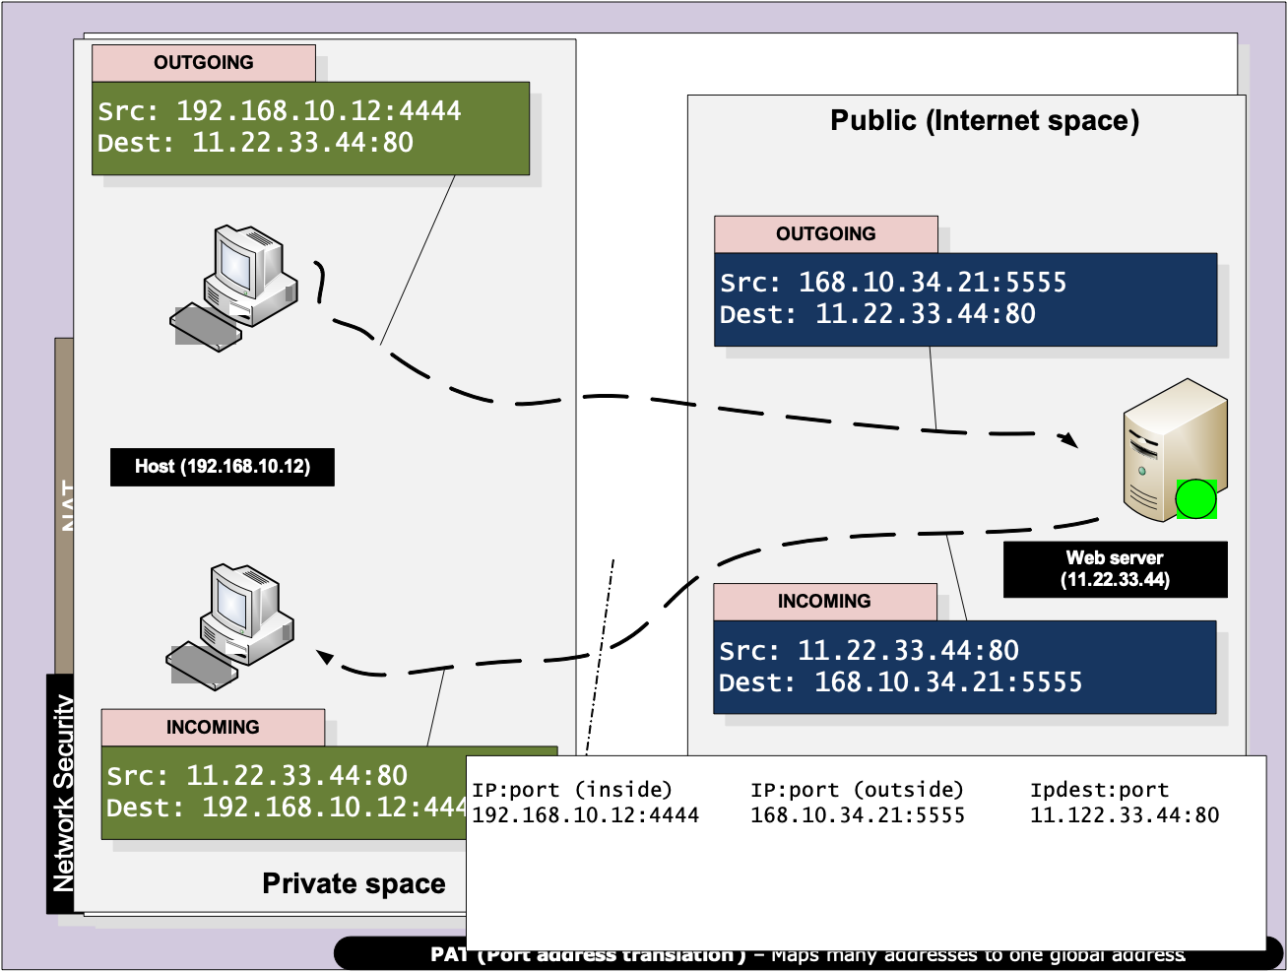
Layered Model

Slide 46
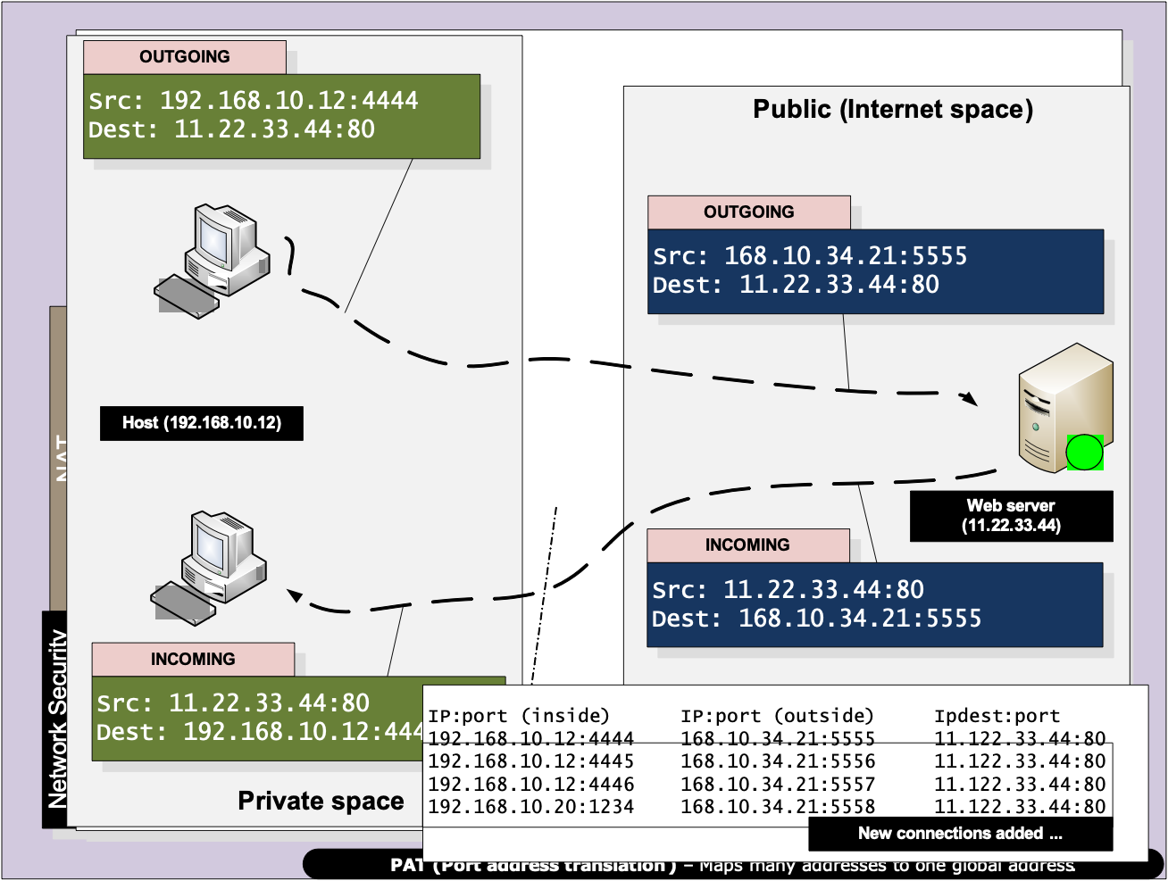
Layered Model

Slide 47
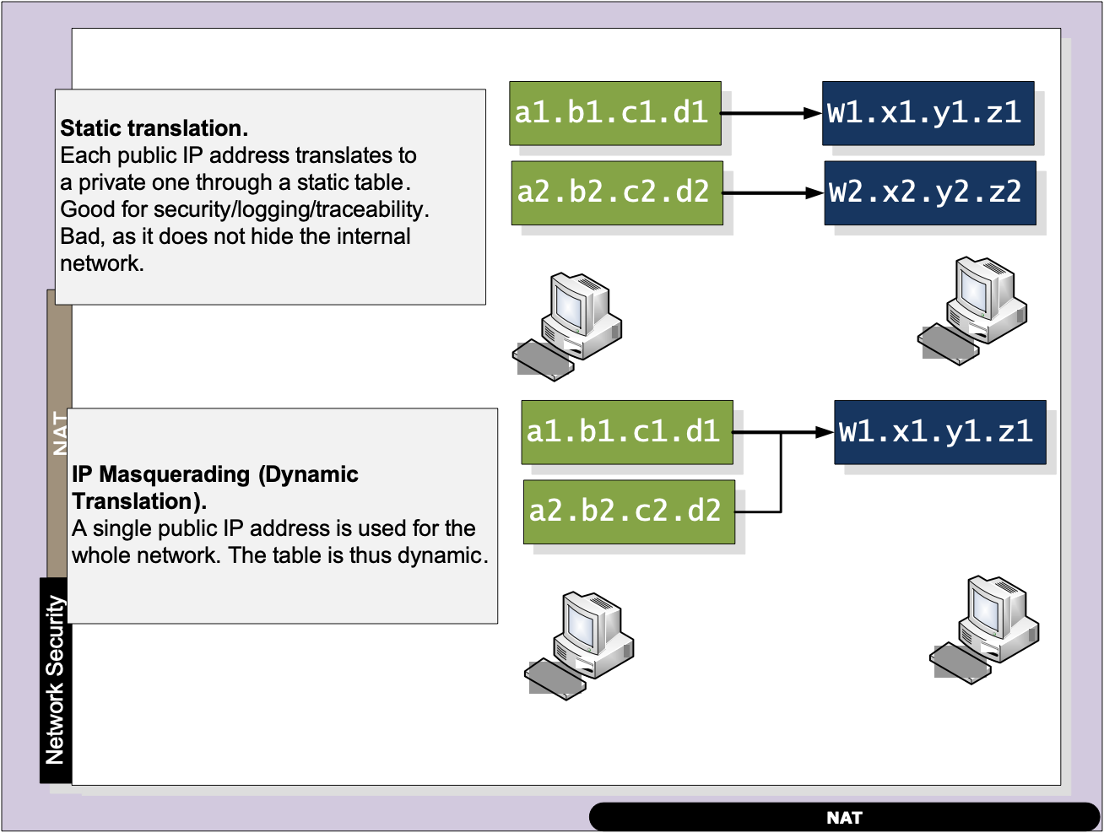
Layered Model

Slide 48
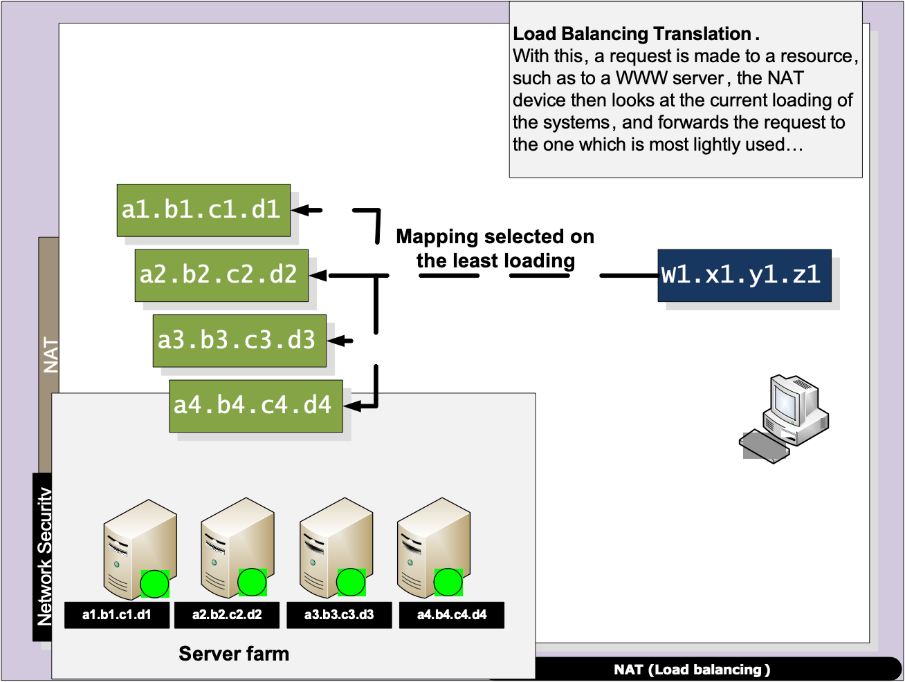
Layered Model

Slide 49
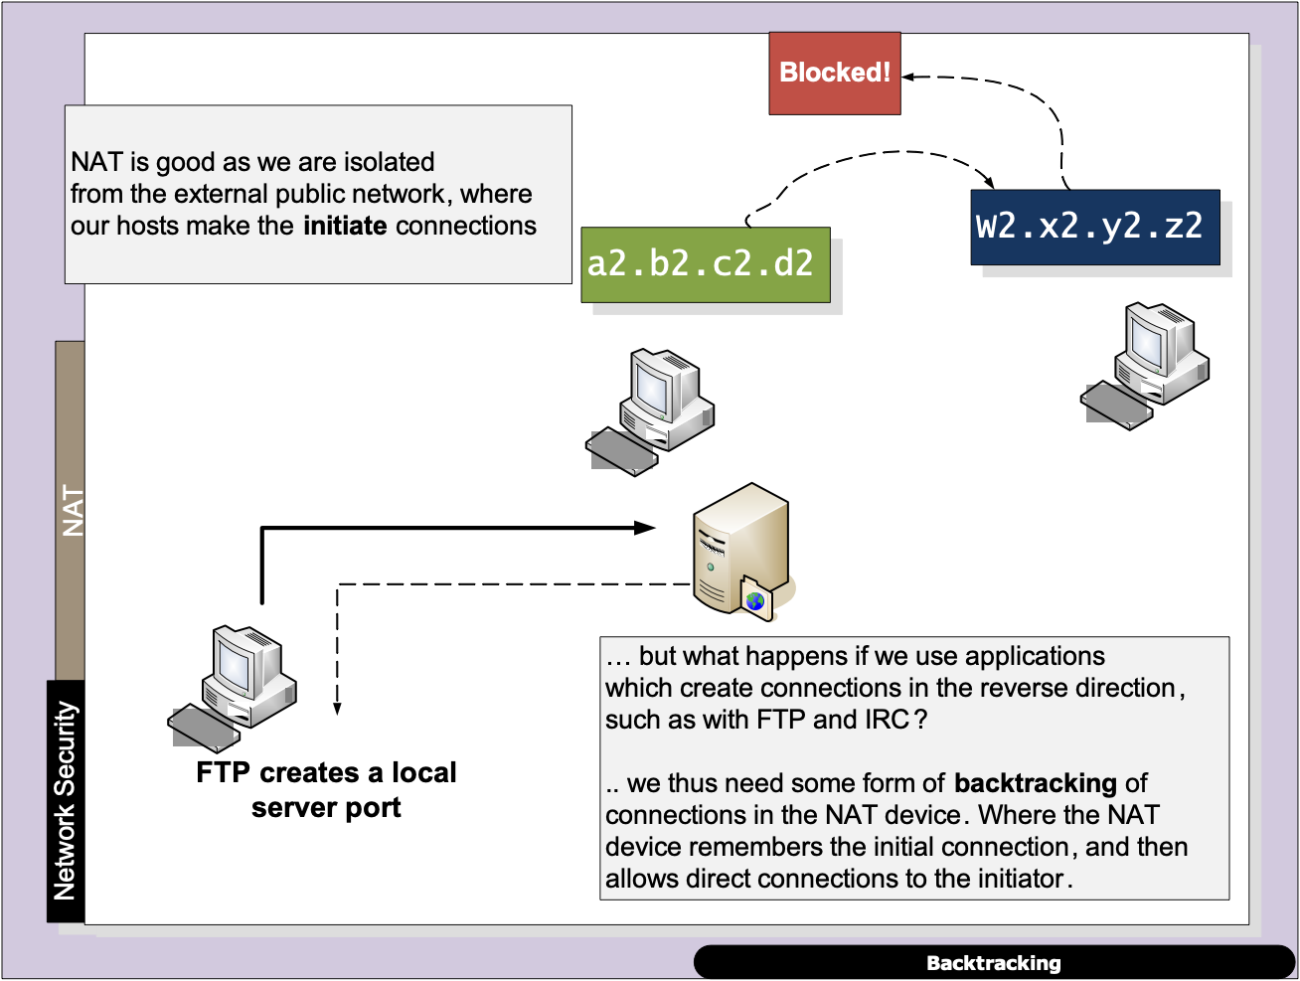
Layered Model

Slide 50
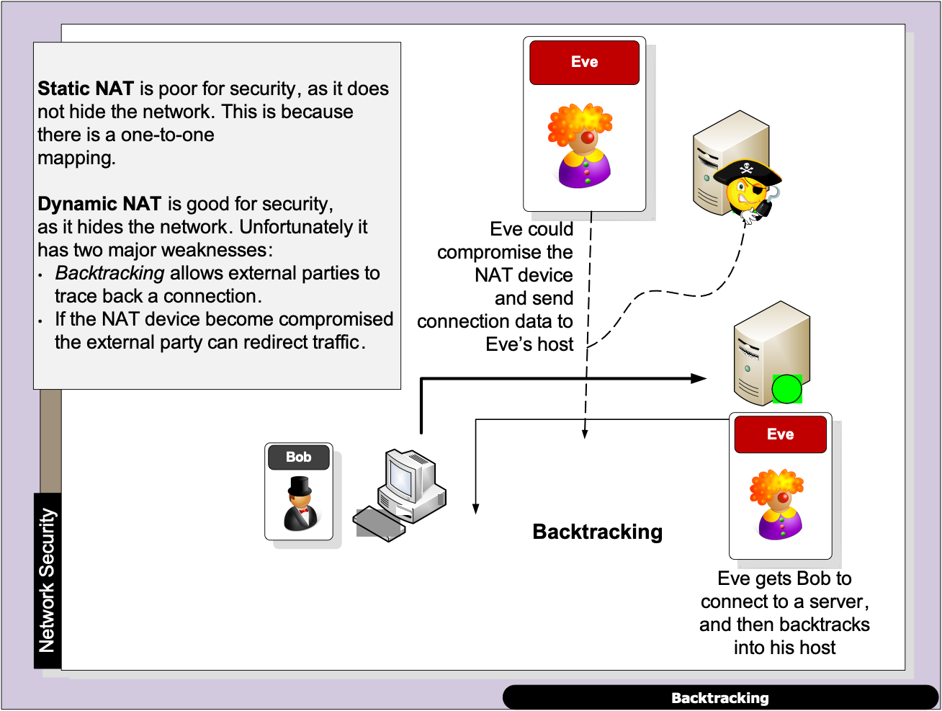
Layered Model

Slide 51
Stateful Firewalls
“From bits to information”

Slide 52
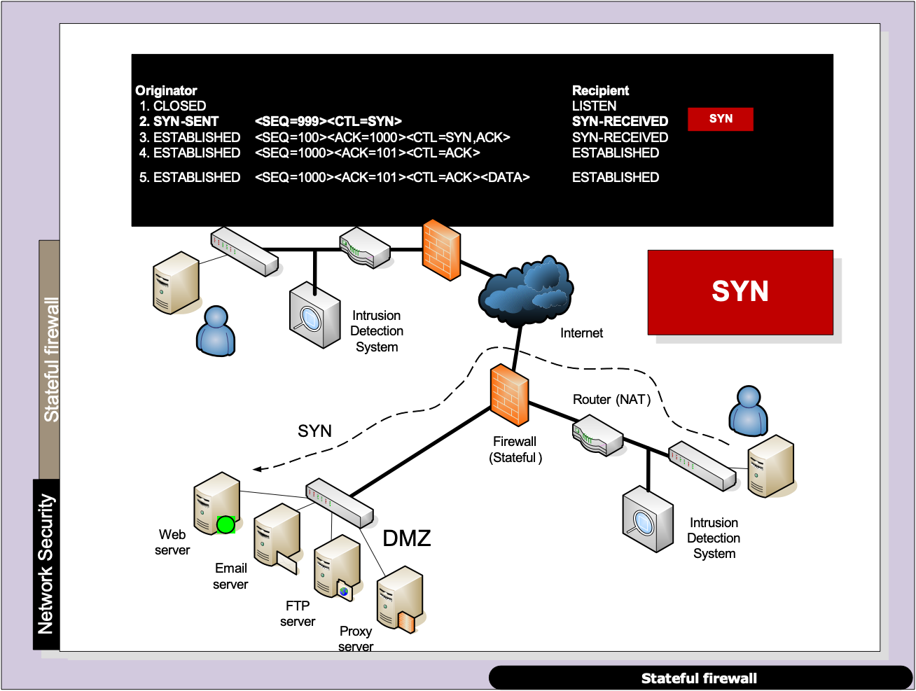
Layered Model

Slide 53
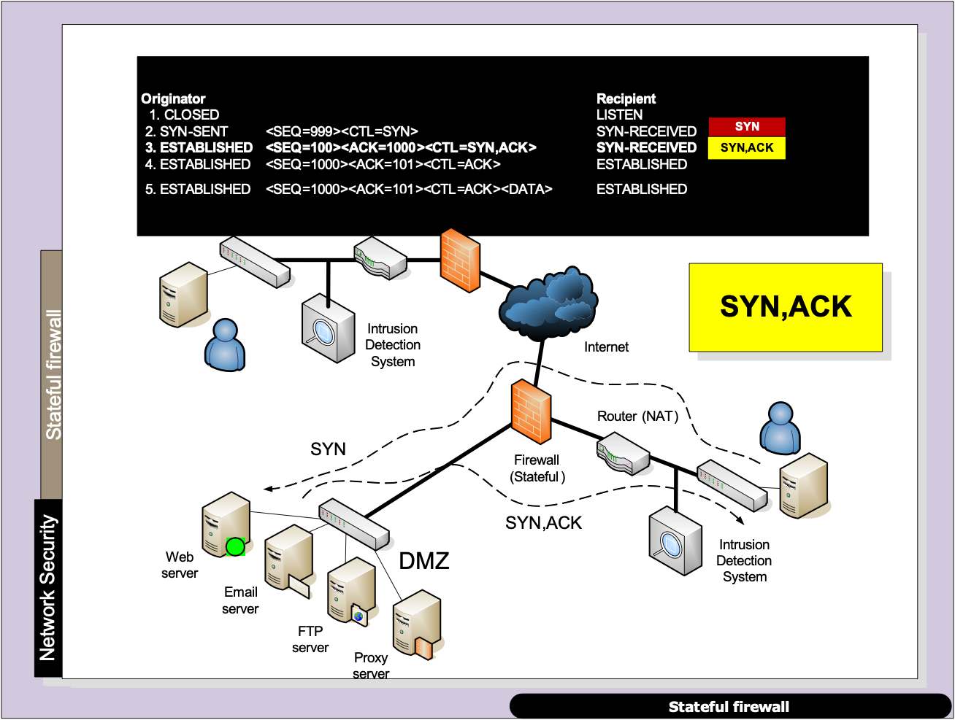
Layered Model

Slide 54
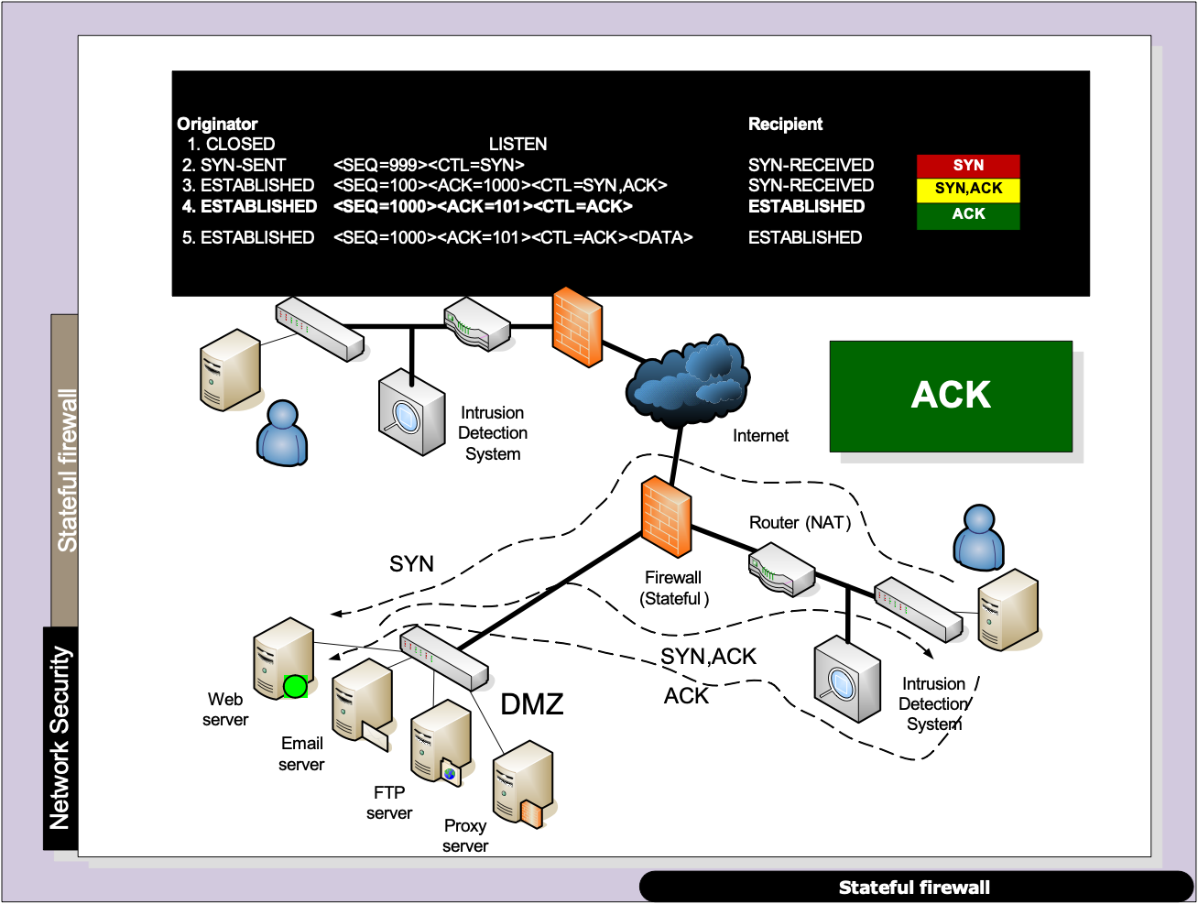
Layered Model

Slide 55
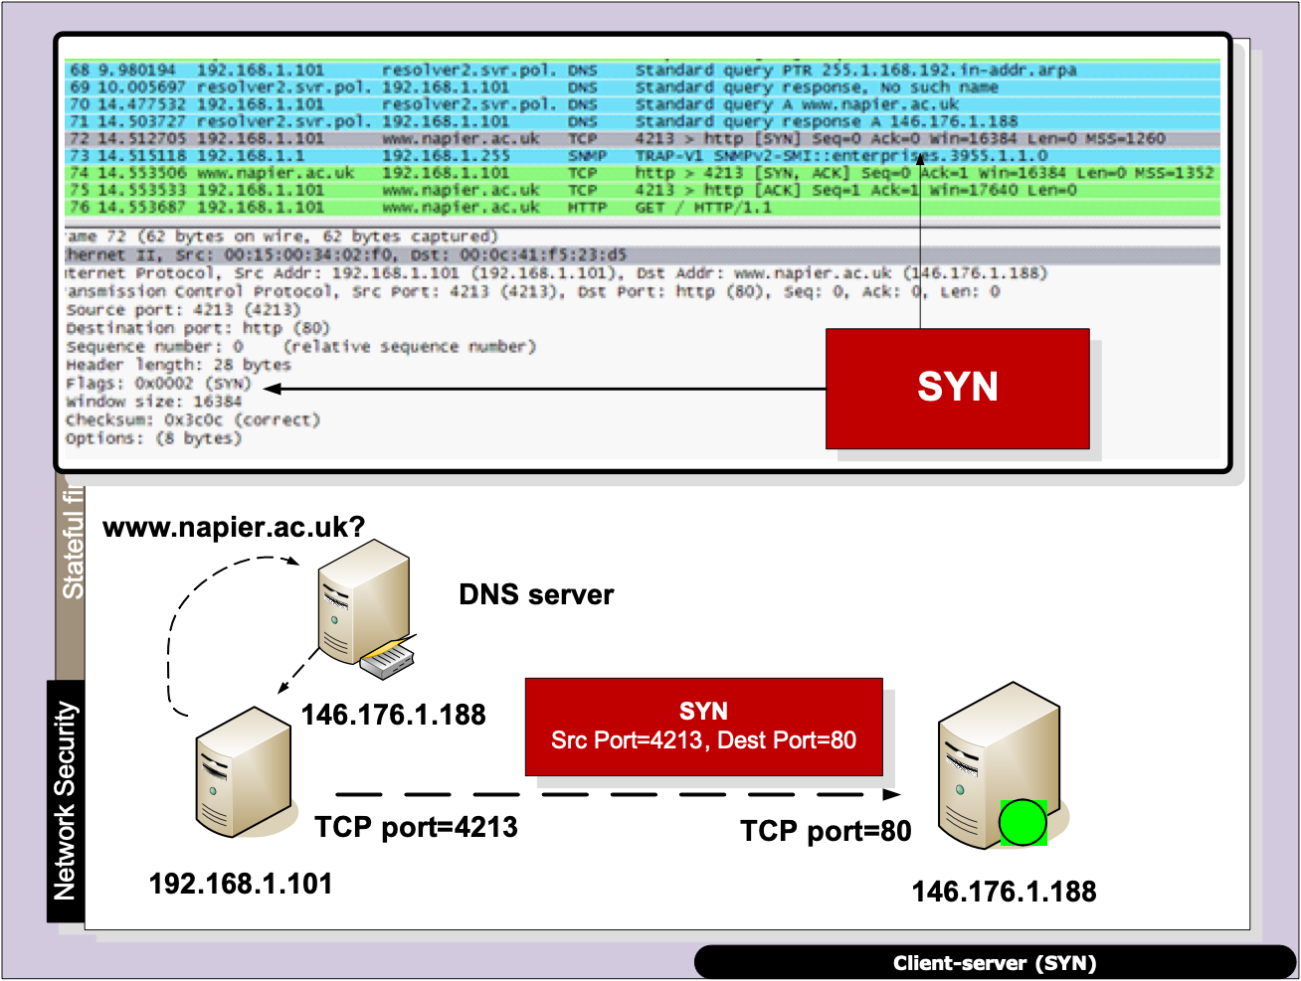
Layered Model

Slide 56
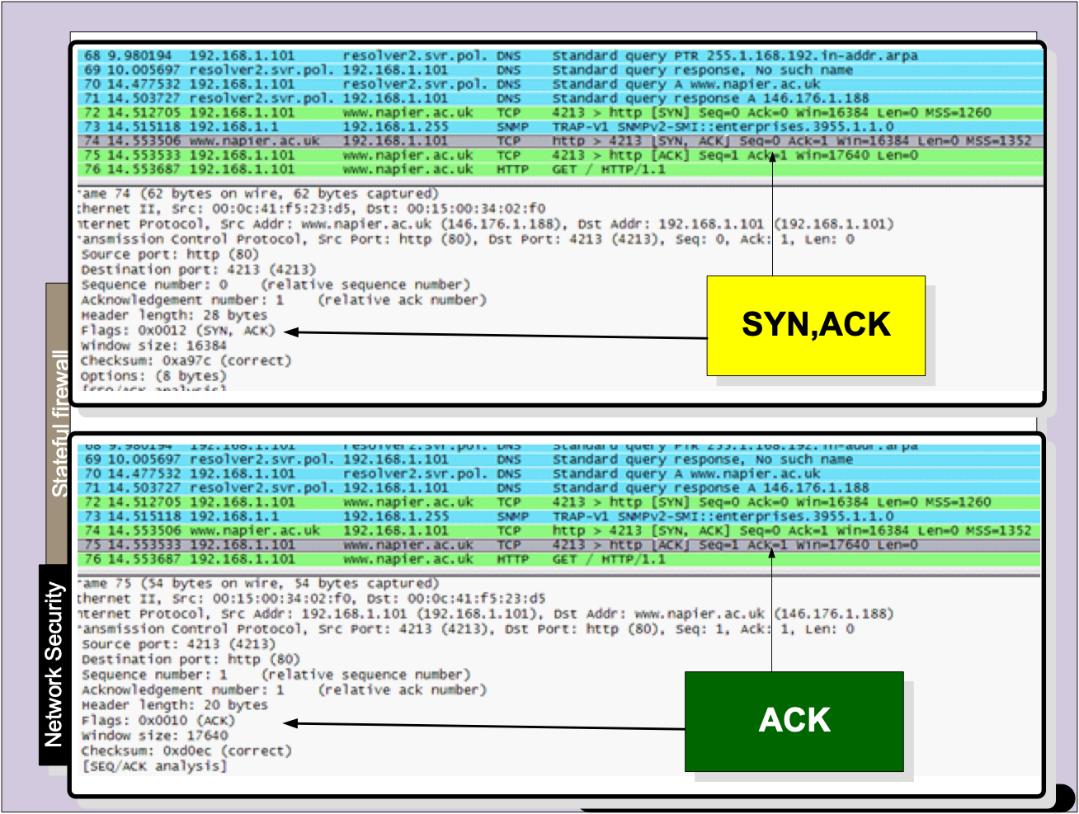
Layered Model

Slide 57
Proxies
“From bits to information”

Slide 58
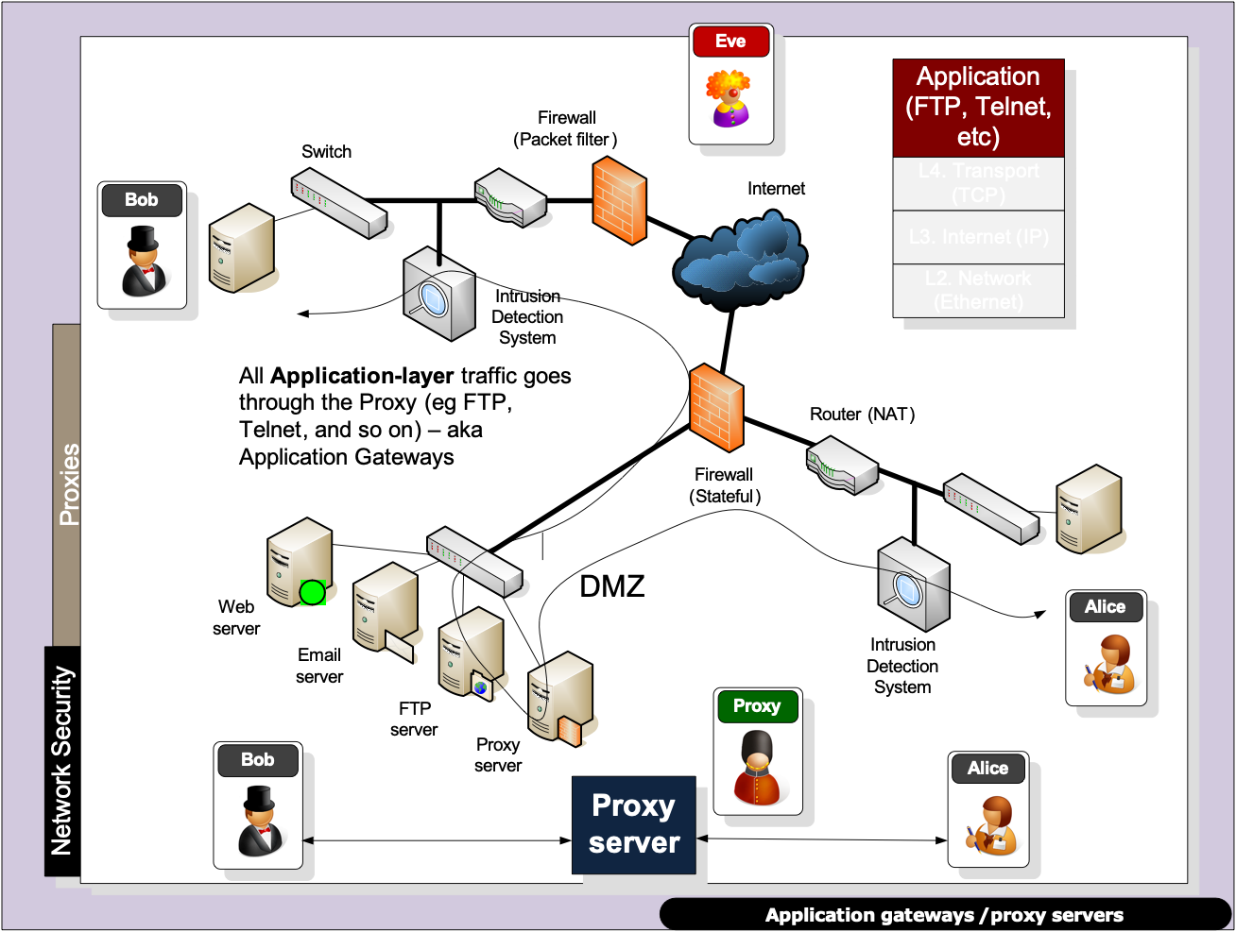
Layered Model

Slide 59
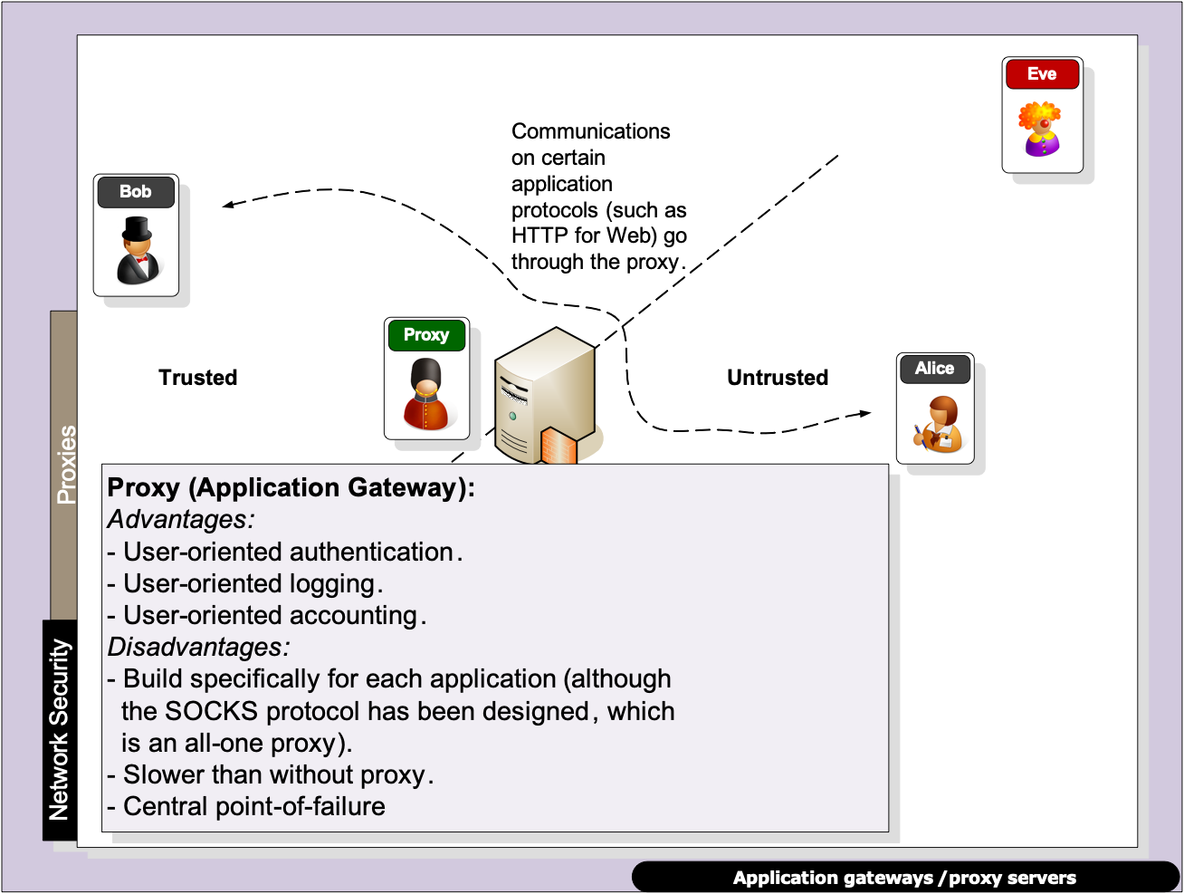
Layered Model

Slide 60
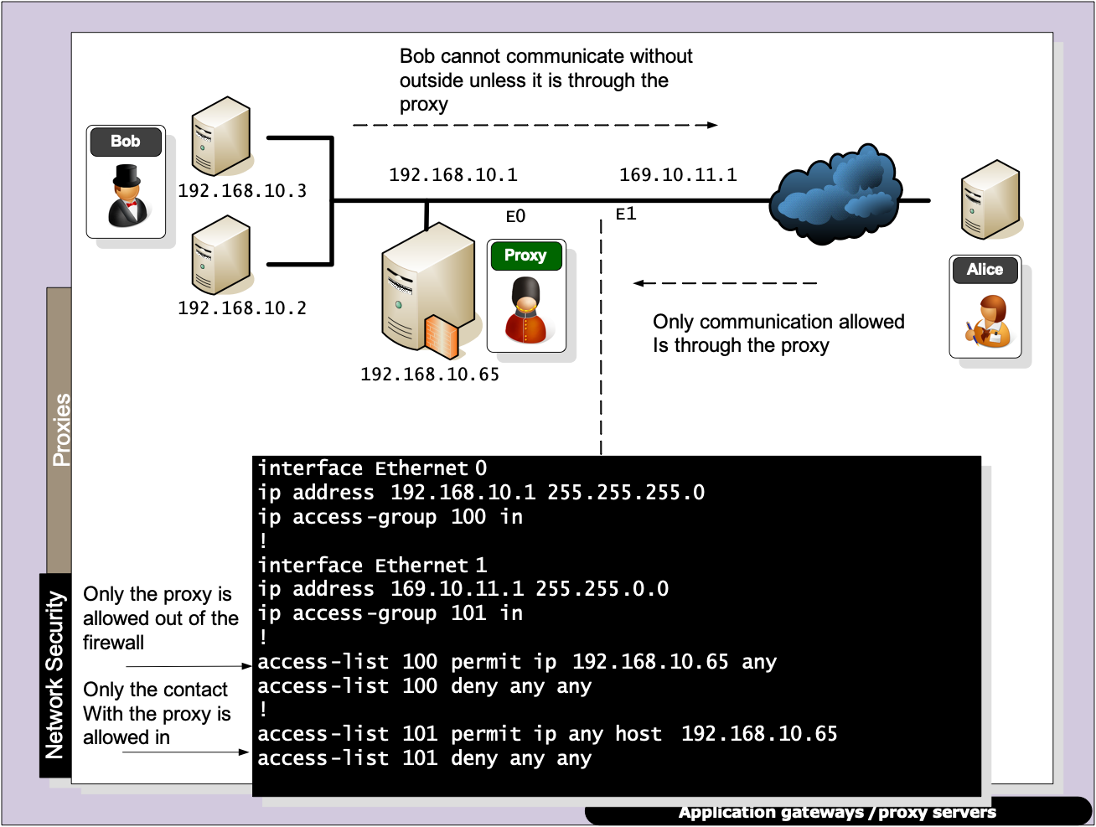
Layered Model

Slide 61
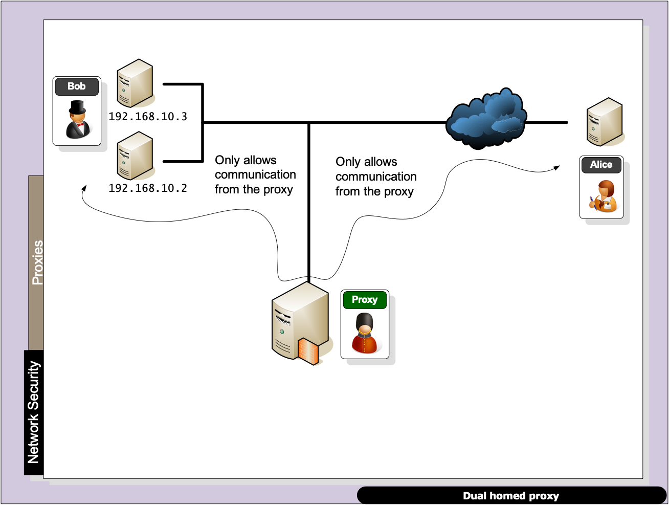
Layered Model

Slide 62
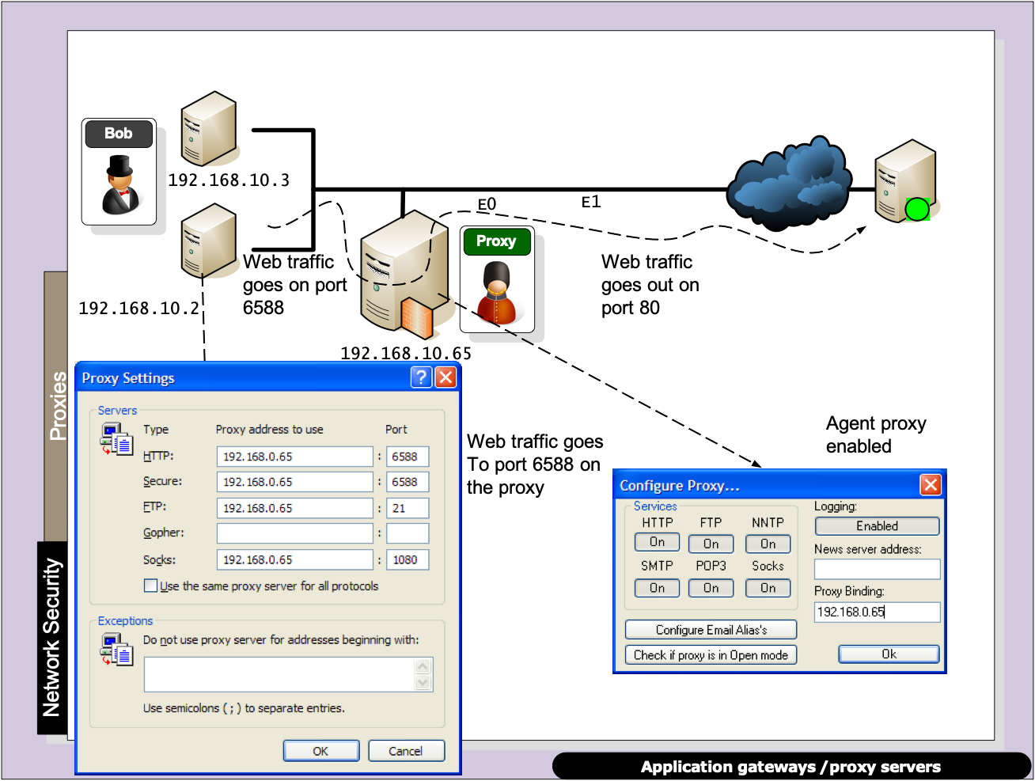
Layered Model

Slide 63

Layered Model

Slide 64

Layered Model

Slide 65

Layered Model

Slide 66

Layered Model

Slide 67
Defence Systems, Policies and Risks
“From bits to information”

